Slide 1
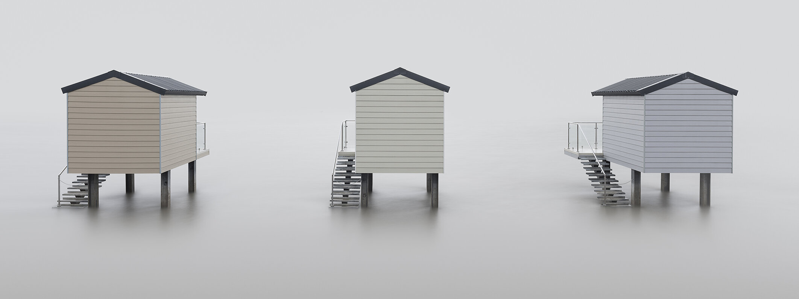

Long exposure photography
(Burnell, n.d.)
Altered Reality Landscapes
Stephen Long 2013003477
Notes:
Introduction:
Topic is long exposure landscape photography
It has the ability to alter perception of time in a still image and convey a sense of mystery and mood

Slide 2
What is long exposure photography?
A shutter speed slower than around ½ second.
Usually done on a tripod.
Creative long exposure techniques can be hand-held.
Notes:
While there is no exact definition of what makes a long exposure, it can be regarded

Slide 3
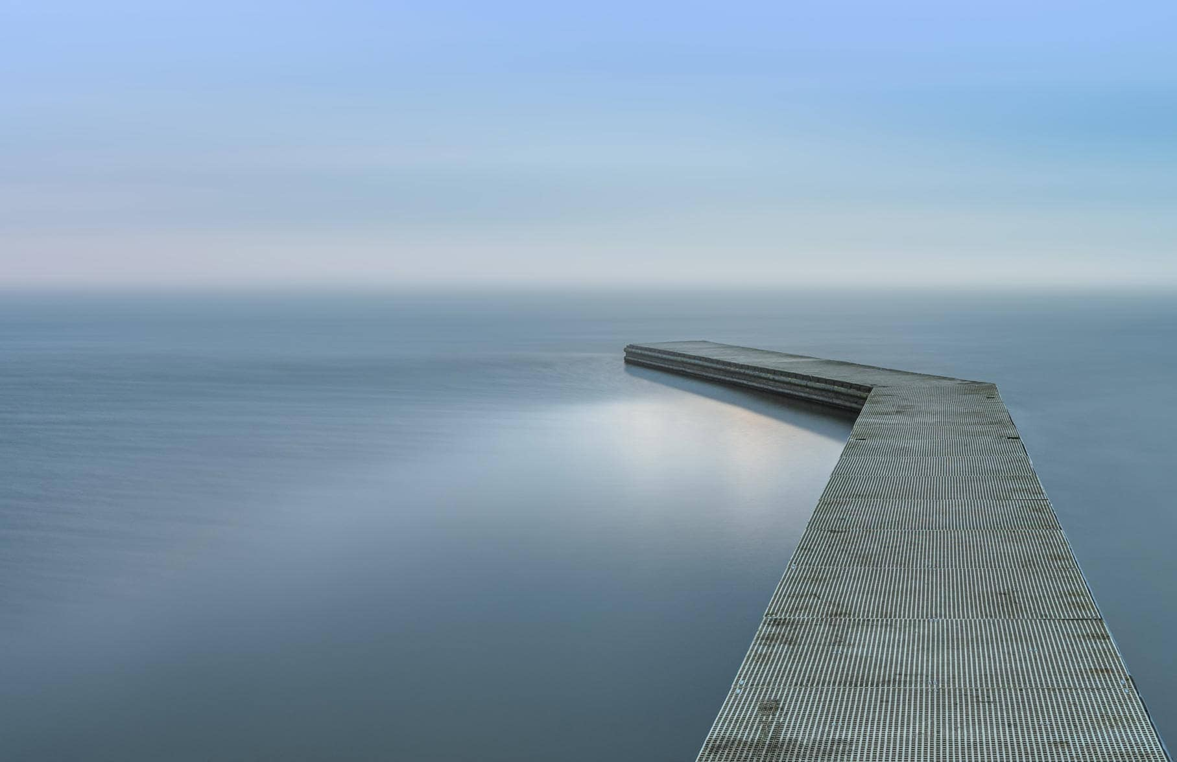
(Davies, 2013)
Notes:
It can be used in many different scenarios
As a creative tool to alter the sense of reality of an image

Slide 4
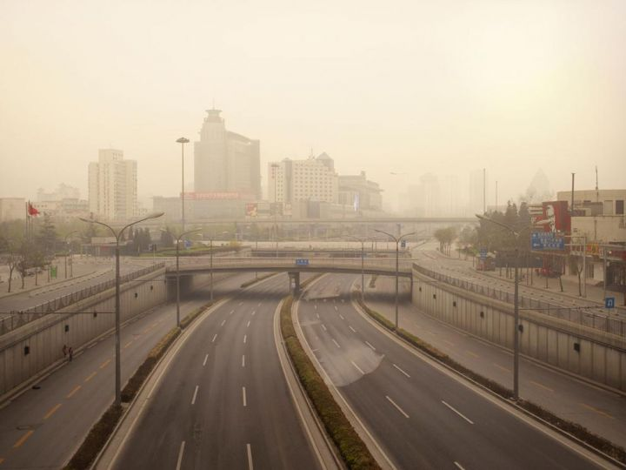
(Brodbeck & De Barbuat, 2012)
Notes:
To remove moving people from a scene or create a sense of motion through blurring

Slide 5
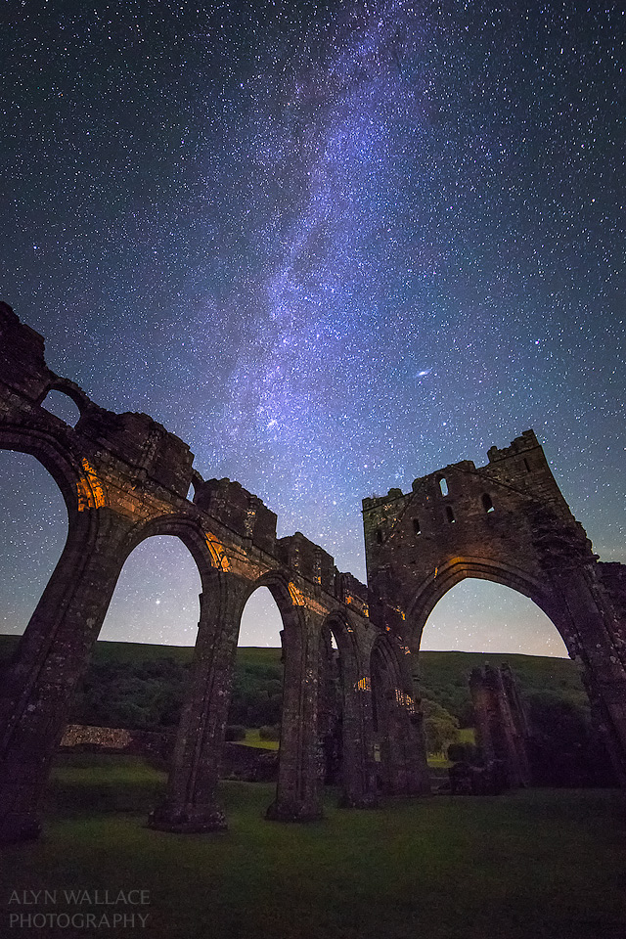
(Wallace, n.d.)
Notes:
To shoot the night sky

Slide 6
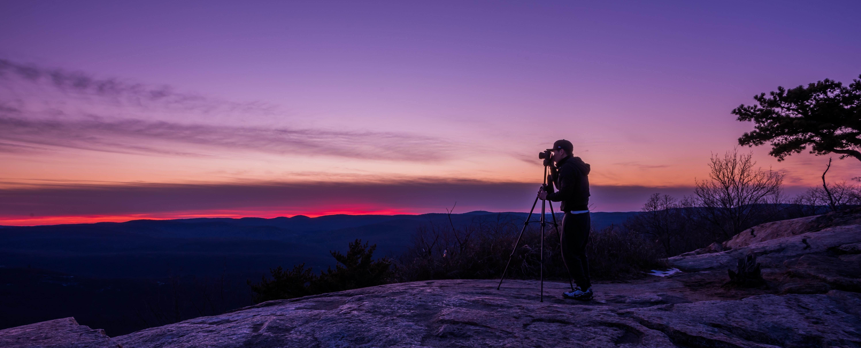
(Williams, n.d.)
Notes:
Low light situations

Slide 7
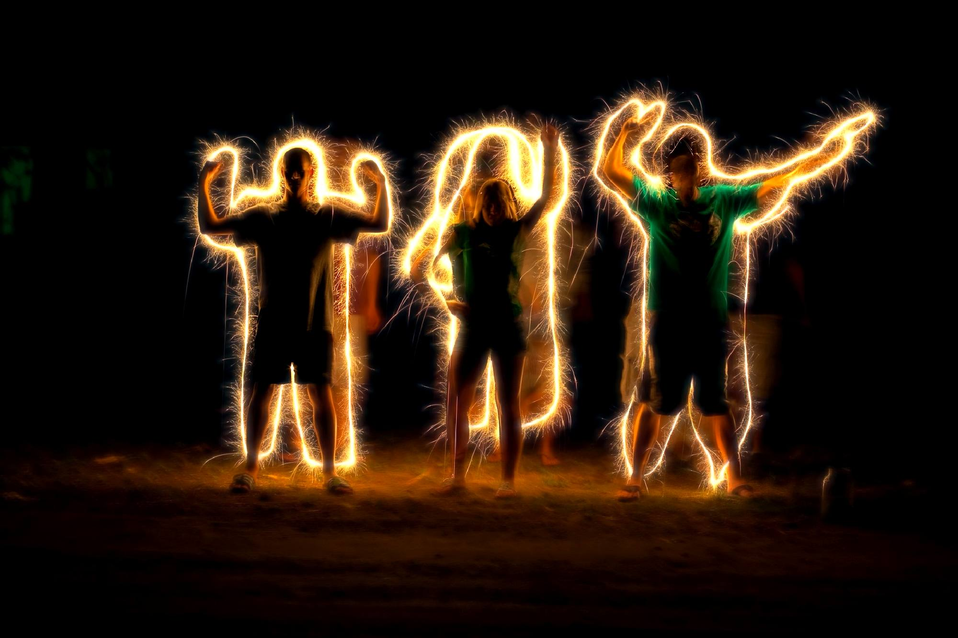
(Lopin, n.d.)
Notes:
Create light trails and light painting

Slide 8
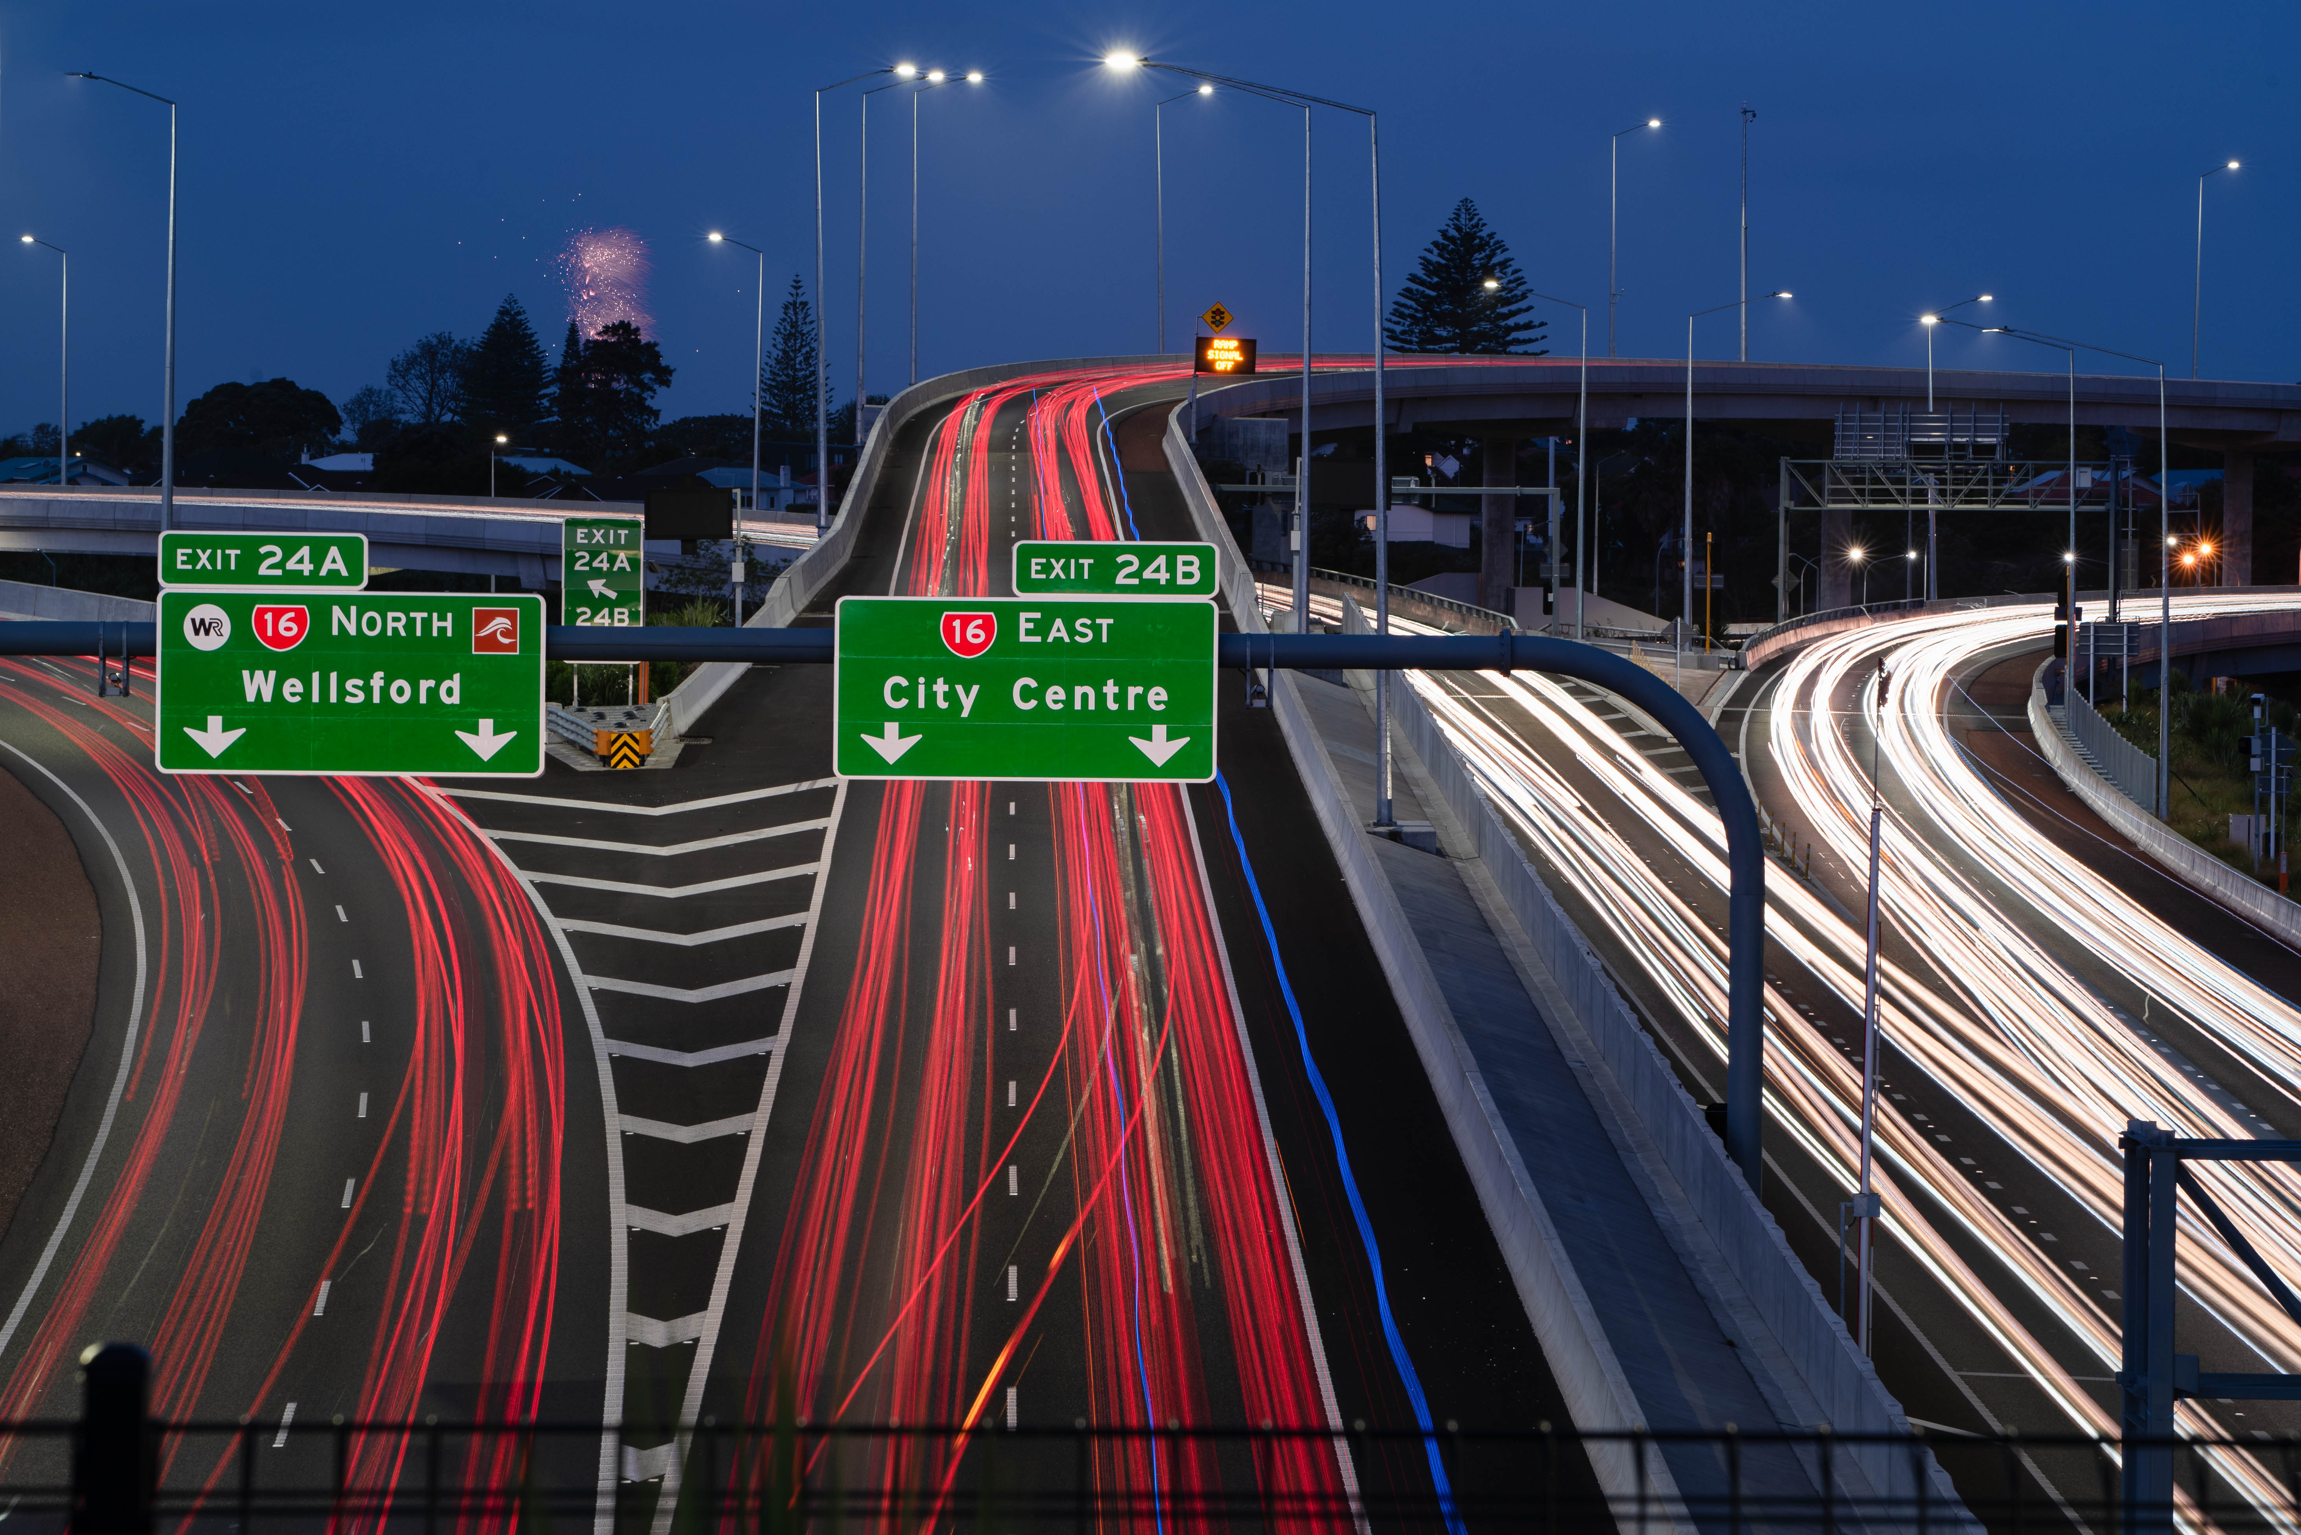
(photograph by author, 2018 )
Notes:
Create light trails

