Slide 1
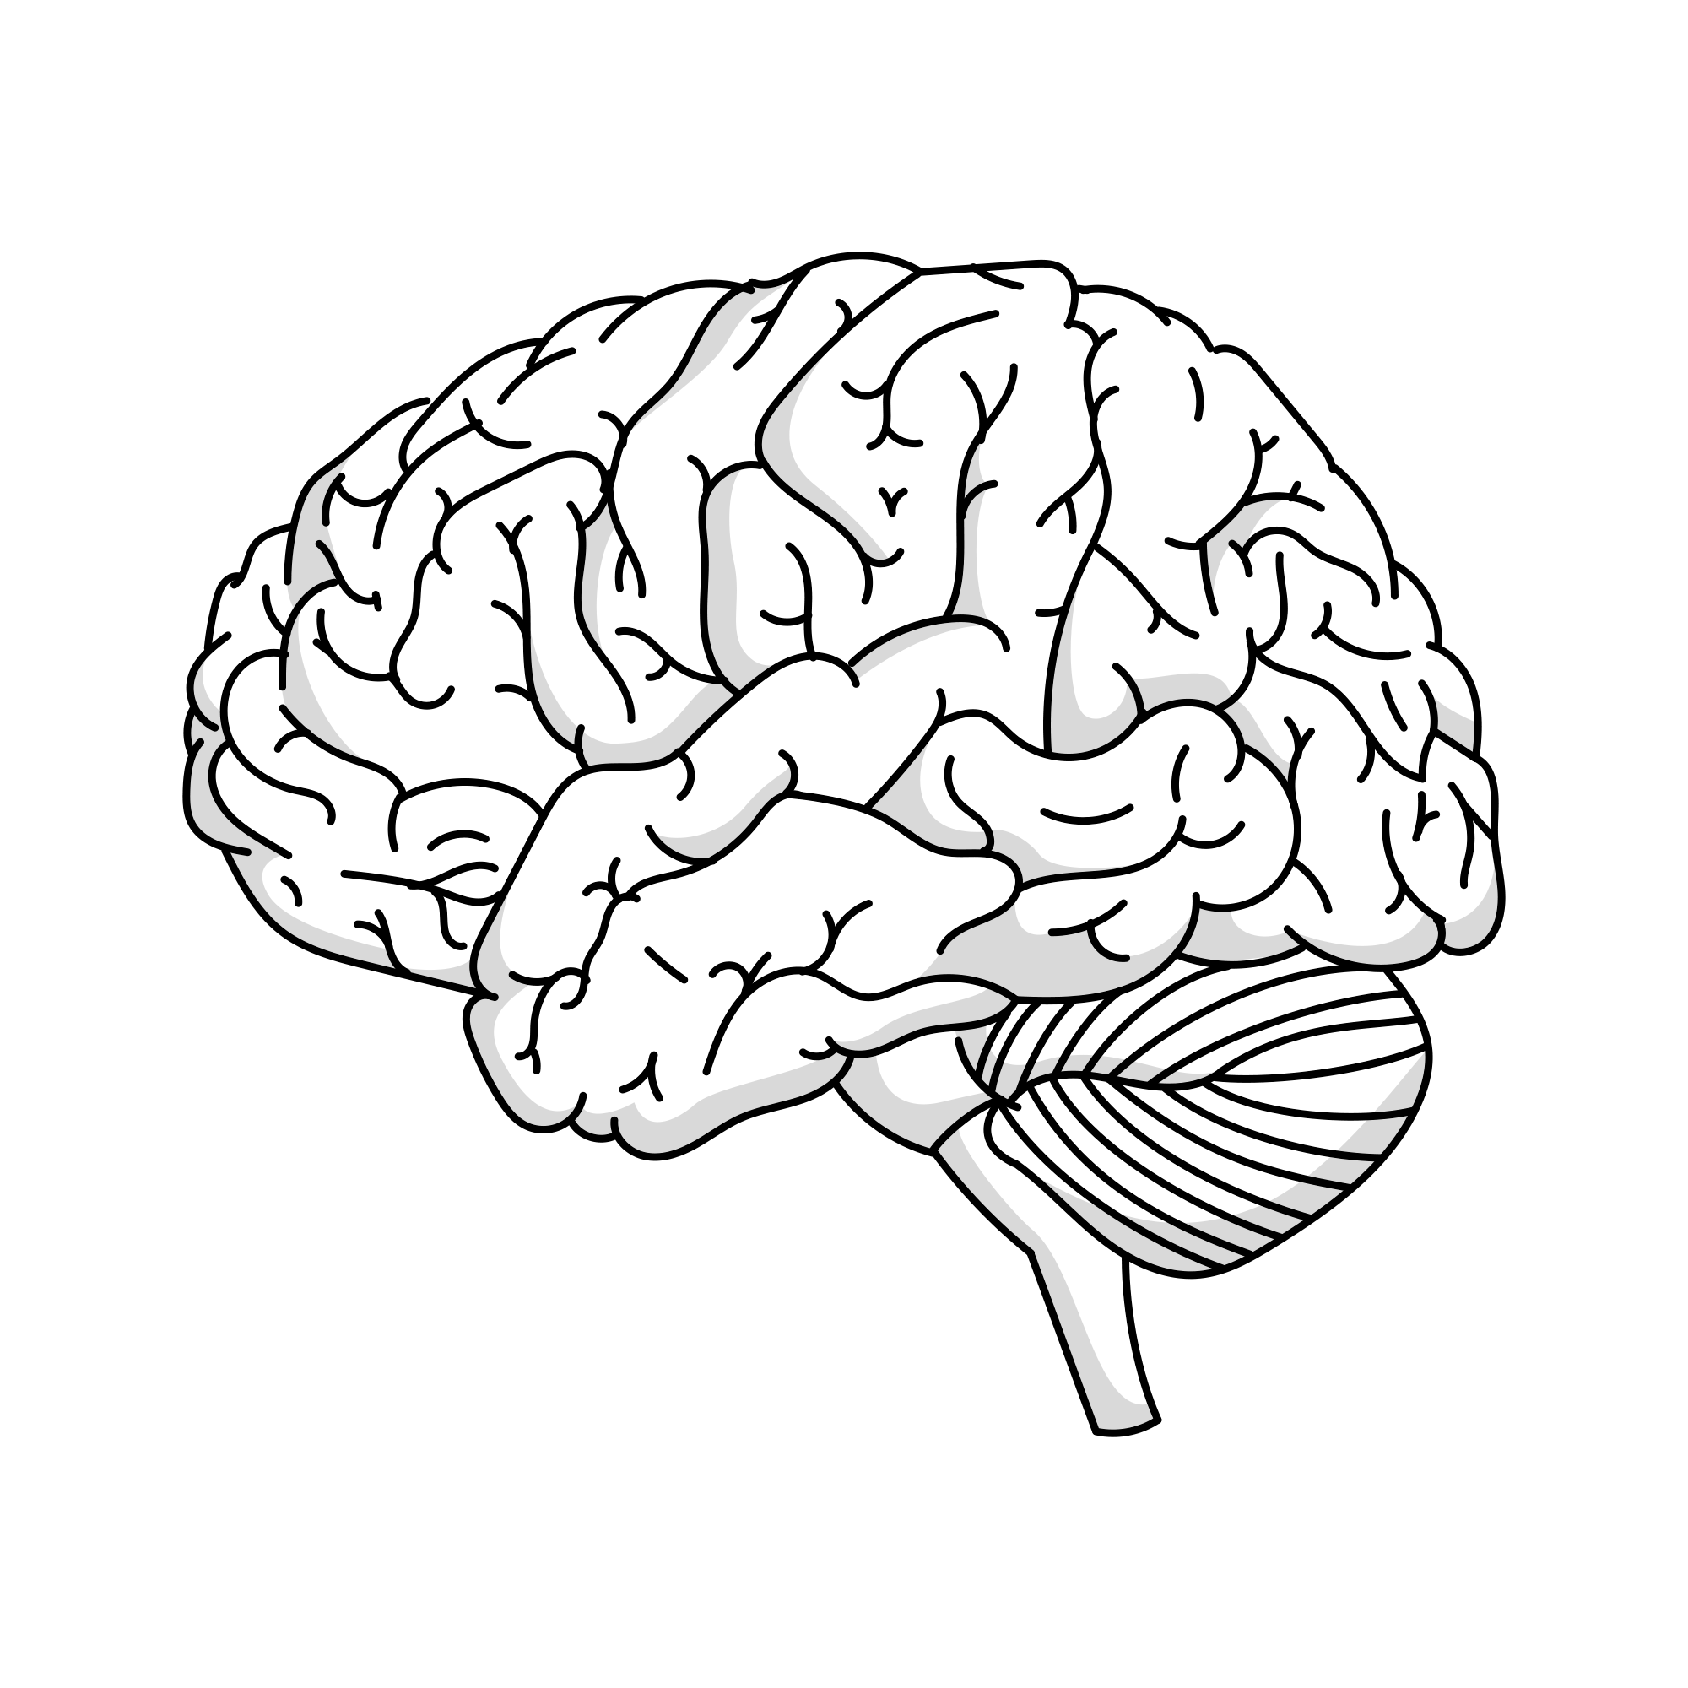
[Type your explanation here.]
No dyslexia

Slide 2
[Type your explanation here.]
Dyslexia before intervention

Slide 3
[Type your explanation here.]
Dyslexia following intervention

