Slide 1
Insert Corporate logo here
© Commonwealth of Australia and the States and Territories of Australia 2020, published by the Australian Building Codes Board.
Notes:
NCC Essentials – NCC Volume One
The following notice does not form part of the NCC Essentials script.
Copyright
© Commonwealth of Australia and the States and Territories of Australia 2020, published by the Australian Building Codes Board.
The material in this publication is licensed under a Creative Commons Attribution—4.0 International licence, with the exception of: any third party material, any trademarks, and any images or photographs. More information on this CC BY licence is set out at the Creative Commons Website. Enquiries about this publication can be sent to:
Australian Building Codes Board ,GPO Box 2013, CANBERRA ACT 2601
Phone: 1300 134 631
Email: ncc@abcb.gov.au www.abcb.gov.au
Attribution
Use of all or part of this publication must include the following attribution:
© Commonwealth of Australia and the States and Territories 2020, published by the Australian Building Codes Board.
Disclaimer
By accessing or using this publication, you agree to the following:
While care has been taken in the preparation of this publication, it may not be complete or up-to-date. You can ensure that you are using a complete and up-to-date version by checking the Australian Building Codes Board website (www.abcb.gov.au).
The Australian Building Codes Board, the Commonwealth of Australia and States and Territories of Australia do not accept any liability, including liability for negligence, for any loss (howsoever caused), damage, injury, expense or cost incurred by any person as a result of accessing, using or relying upon this publication, to the maximum extent permitted by law. No representation or warranty is made or given as to the currency, accuracy, reliability, merchantability, fitness for any purpose or completeness of this publication or any information which may appear on any linked websites, or in other linked information sources, and all such representations and warranties are excluded to the extent permitted by law.
This publication is not legal or professional advice. Persons rely upon this publication entirely at their own risk and must take responsibility for assessing the relevance and accuracy of the information in relation to their particular circumstances.

Slide 2
Table of contents
Introduction
How it works.
What you will learn.
Contents
An overview of NCC Volume One.
NCC Volume One: Sections A to J.
Summary
Notes:
The introduction will cover how it works and what you’ll learn.
The contents include looking at an overview of NCC Volume One, the various Sections and a brief summary.

Slide 3
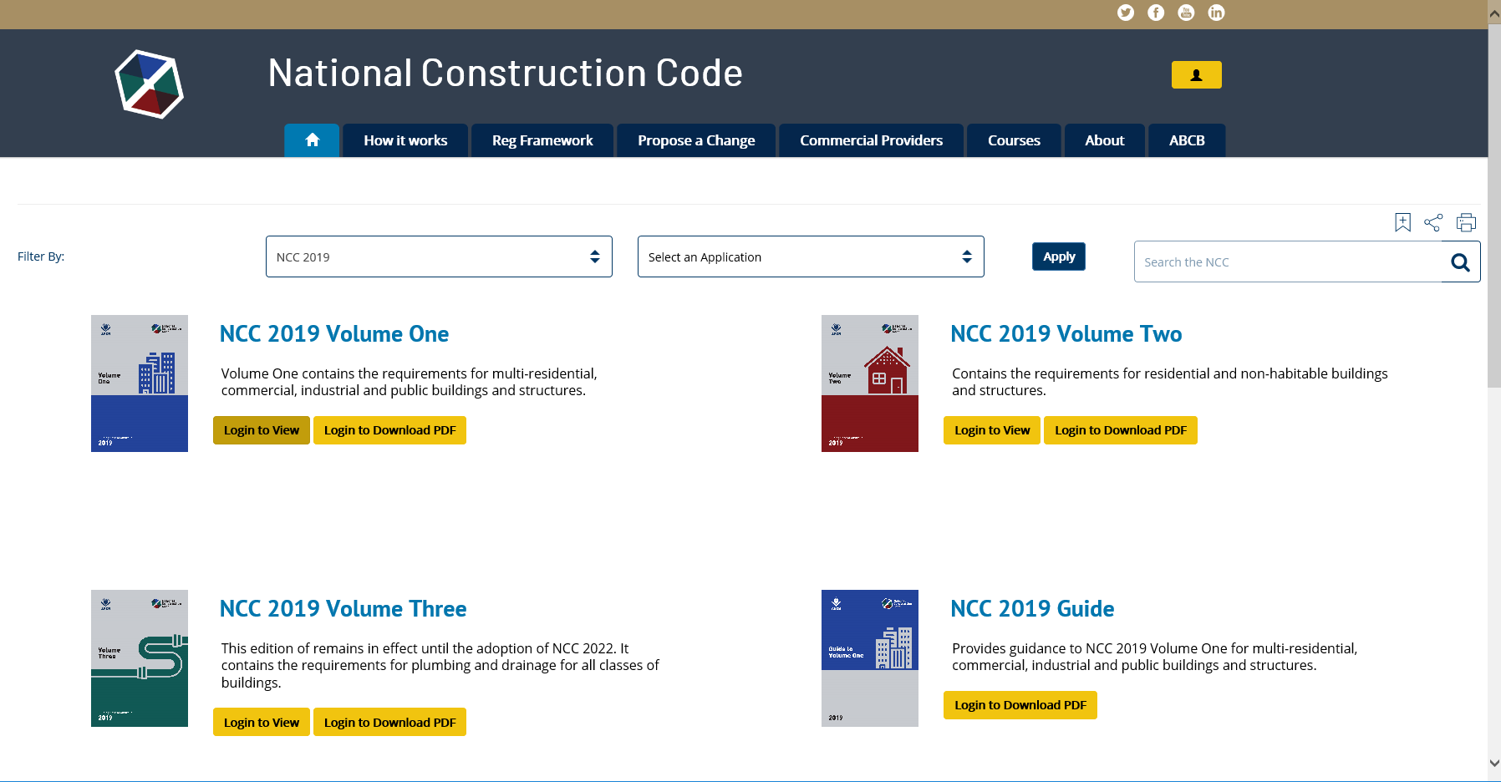
How to access the NCC
To access the NCC, visit: ncc.abcb.gov.au
To access the NCC, register your details here, submit and receive your confirmation email and password
Notes:
The NCC is freely available online via the ABCB website. First time users should select the Register option (top right of the Home page).
Once registered, users are sent a confirmation email that allows access to the NCC online and in downloadable PDF format.

Slide 4
What you will learn
Aims and objectives
To acquire a basic understanding of NCC Volume One, with an emphasis on the various Sections of Volume One.
Who this material is for
All building professionals.
Notes:
So, what will you learn about Volume One of the NCC?
The aim is to have you acquire a basic understanding of the NCC Volume One, with particular emphasis on the various Sections of Volume One.
This material is designed for all building professionals.

Slide 5
Overview of the NCC
The role of the NCC is to provide:
nationally consistent minimum necessary regulations; and
a technical base for the design and construction of buildings and certain structures.
There are three performance-based volumes in the NCC, namely:
the Building Code of Australia (BCA) - Volumes One and Two; and
the Plumbing Code of Australia (PCA) - Volume Three.
Notes:
Firstly, let’s look at the role of the NCC, how it takes effect as a regulatory document, the goals of the NCC and what the NCC applies to.
The NCC is an initiative of the Council of Australian Governments (COAG) to incorporate all on‐site construction requirements into a single code.
Its role is to provide nationally consistent minimum necessary standards and a technical base for the design and construction of buildings throughout Australia.
The Building Code of Australia – often referred to as the ‘BCA’ – makes up Volume One and Volume Two of the NCC.
The NCC Volume One primarily covers Class 2 to Class 9 buildings. Volume Two primarily covers Class 1 and Class 10 buildings.
Volume Three of the NCC is the Plumbing Code of Australia or ‘PCA’. This pertains primarily to plumbing and drainage associated with all classes of buildings.

Slide 6
Overview of the NCC
The NCC applies to:
new construction;
additions and alterations; and
change of use of a building.
The goals of the NCC are to achieve minimum necessary standards relevant to:
safety (including structural safety and safety from fire); and
health, amenity, accessibility and sustainability.
Notes:
Generally, the NCC applies to the construction of new buildings and new building work in existing buildings.
The NCC can also apply to the change of use of a building.
With this in mind, the goal of the NCC is to enable the achievement of nationally consistent, minimum necessary standards of relevant safety (including structural safety and safety from fire), health, accessibility, amenity and sustainability objectives efficiently.

Slide 7
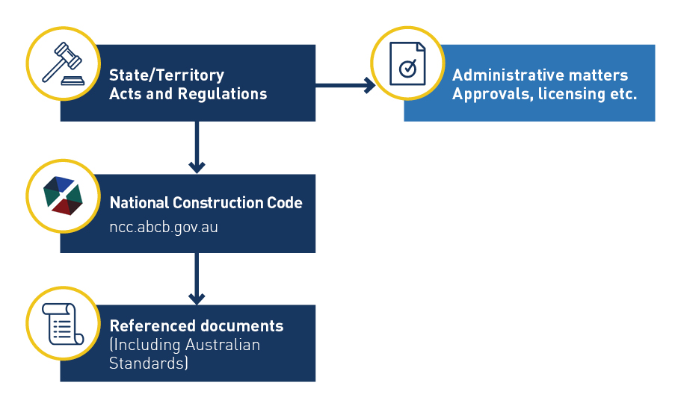
Australian Regulatory Framework
Notes:
The NCC takes effect as a regulatory document through adoption by State and Territory legislation.
A typical regulatory structure will include a State or Territory ‘Act.’
The ‘Act’ has Regulations that go along with it. These Regulations in turn comprise administrative matters like approvals, licensing and other features including the adoption of the NCC.
Via the NCC, documents such as the Australian Standards are referenced, which then become regulatory documents in their own right.

Slide 8
NCC Volume One: Overview
Volume One contains the design and construction requirements for Class 2 to 9 buildings.
It also contains certain requirements for Class 1b, 10a and 10b buildings and structures.
Class 2 to 9 buildings are generally commercial, industrial, multi-residential, and institutional buildings.
Volume One contains nine distinct Sections (A to J).
Notes:
Let’s look at Volume One in greater detail.
Volume One of the NCC contains the design and construction requirements for Class 2 to 9 buildings as well as certain requirements for Class 1b, 10a and 10b buildings. These requirements cover such matters as structure, fire resistance, access and egress, services and equipment, and energy efficiency as well as certain aspects of health and amenity.
Class 2 to 9 buildings are generally commercial, industrial, multi‐residential, and institutional buildings.
Volume One has nine specific Sections, however, before we get into each of these Sections we will take a closer look at the structure and compliance requirements for Volume One.

Slide 9
NCC Volume One: Overview
NCC Volume One is a performance-based code.
Compliance with the NCC is achieved by satisfying the Governing Requirements and the Performance Requirements.
Notes:
As with NCC Volumes Two and Three, NCC Volume One is a performance-based code.
Compliance with the NCC is achieved by satisfying the Governing Requirements and the Performance Requirements.
The top level, the Performance Requirement is the Compliance Level. The bottom level are the Compliance Solutions, which are Performance Solutions and/or Deemed‐to‐Satisfy Solutions.
The NCC Compliance Structure shown is located in the Governing Requirements of the NCC in Part A2.

Slide 10
Performance Requirements
Performance Requirements are located at the start of each Section of Volume One.
A2.1 of the Governing Requirements outlines the three ways you can achieve compliance with the mandatory Performance Requirements.
The Performance Requirements can only be satisfied by either a:
(a) Performance Solution; or
(b) Deemed-to-Satisfy Solution; or
(c) combination of (a) and (b).
Notes:
Remember, a performance-based code allows for flexibility in approaches, to satisfy the Performance Requirements. Therefore a solution that complies with the Deemed‐to‐Satisfy Provisions is only one means of meeting the Performance Requirements. The other approaches are shown in A2.1 of the Governing Requirements.
Performance Solutions give practitioners the flexibility to do things differently from the Deemed‐to‐Satisfy Provisions, potentially providing a more cost-effective design and improving constructability. This could be based on existing or new innovative systems and designs.
The third option to comply with the Performance Requirements is by using a combination of both Deemed‐to‐Satisfy Provisions and Performance Solutions.
All solutions must be assessed in accordance with one or more of the Assessment Methods listed in Part A2 of Volume One.
An Assessment Method or Methods must be used to determine compliance with the Performance Requirements relevant to the solution that is being proposed.

Slide 11
Performance Requirements
The first Clause within each Section or Part of Volume One states the relevant Performance Requirements that need to be satisfied.
Note the extract below for the relevant Performance Requirements for Part B1 Structural Provisions, Deemed-to-Satisfy Provisions.
Notes:
Within Volume One the first clause within each Section or Part states which Performance Requirements are satisfied by complying with certain DTS Provisions, as can be seen in the extract from Part B1.
The Deemed‐to‐Satisfy Provision B1.0 (a) states that:
“Where a Deemed-to-Satisfy Solution is proposed, Performance Requirements BP1.1 to BP 1.4 are satisfied by complying with B1.1, B1.2, B1.4, B1.5 and B1.6.”
B1.0(b) states: “Where a Performance Solution is proposed, the relevant Performance Requirements must be determined in accordance with A2.2(3) and A2.4(3) as applicable.”
The NCC Essentials topic, NCC: a performance-based Code provides greater detail about Performance Solutions, Assessment Methods and determining the appropriate Performance Requirements.

Slide 12
Performance Requirements: Limitations
Notes:
The Deemed‐to‐Satisfy Provisions contained in Sections B to J generally reflect commonly accepted industry practices and standards and the common materials used.
The Deemed‐to‐Satisfy Provisions make up the bulk of the content of Volume One.
Because NCC Volume One applies to a broad range of buildings e.g. commercial, industrial, multi‐residential, and institutional buildings, it is important to note that many of the Performance Requirements and Deemed‐to‐Satisfy Provisions may have limited application, which is generally dependent on the specific “Class or Classes” of building i.e. not all requirements apply to all designs.
An example of this can be seen in the extracts provided from Volume One for Performance Requirement DP6 and Deemed‐to‐Satisfy Provision E1.8.
Performance Requirement DP6 contains a Limitation box which details that the requirements of DP6 are not applicable to internal parts of sole‐occupancy units in Class 2 or 3 buildings or a Class 4 part of a building.
The application of a Deemed‐to‐Satisfy Provision may also have limited application, dependent on other triggers such as the height of the building, floor area, layout etc., as can be seen in the extract from E1.8.

Slide 13
NCC Volume One: Sections
Section A – Governing Requirements
Section B - Structure
Section C - Fire resistance
Section D - Access and egress
Section E - Services and equipment
Section F - Health and amenity
Section G - Ancillary provisions
Section H - Special use buildings
Section J - Energy efficiency
Notes:
Let’s move on to the Sections of Volume One. Volume One has nine Sections, which are:
Section A – Governing Requirements;
Section B – Structure;
Section C – Fire resistance;
Section D – Access and egress;
Section E – Services and equipment;
Section F – Health and amenity;
Section G – Ancillary provisions (swimming pool fencing, bushfire prone areas);
Section H – Special use buildings (theatres, stages, public transport, farm buildings); and
Section J – Energy efficiency.
It should be noted that the content of Section I, which existed in previous editions of Volume One, was removed from the NCC in 2014. The Section and Part numbers have been retained so as not to change the numbering from previous editions.
We will cover each of these Sections in more detail in the remaining slides.
It is important to remember that whilst Volume One of the NCC has nine distinct Sections, the provisions of the code need to be looked at holistically in application. This is particularly important in the formation of a Performance Solution, as the altering of one section of the code may effect other sections.
For example, formulating a Performance Solution to increase the prescribed distance of travel to an exit from Section D, may have an effect on the coverage requirements for fire fighting equipment (from Section E).
The Performance Requirements are located at the start of each Section with the exception of Section A, which has no Performance Requirements.

Slide 14
NCC Volume One: Schedules
Schedule 1: State and Territory Appendices
Schedule 2: Abbreviations and symbols
Schedule 3: Definitions
Schedule 4: Referenced documents
Schedule 5: Fire-resistance of building elements
Schedule 6: Fire hazard properties
Schedule 7: Fire Safety Verification Method
Notes:
Volume One also has a number of Schedules. These include:
Schedule 1: State and Territory Appendices;
Schedule 2: Abbreviations and symbols;
Schedule 3: Definitions;
Schedule 4: Referenced documents;
Schedule 5: Fire-resistance of building elements;
Schedule 6: Fire hazard properties; and
Schedule 7: Fire Safety Verification Method.

Slide 15
Section A: Governing Requirements
Section A: Governing Requirements of the NCC provides the rules and instructions for using and complying with the NCC. Information is provided on the following:
Interpreting the NCC.
Complying with the NCC.
Application of the NCC in States and Territories.
Applying documents referenced in the NCC.
Documenting the suitability of the design, construction and/or use of materials to comply with the NCC.
Classifying buildings by their characteristics and intended use.
Notes:
Now let’s look at the specific sections in detail.
Section A: Governing Requirements of the NCC provides the rules and instructions for using and complying with the NCC. Information is provided on the following:
Interpreting the NCC.
Complying with the NCC.
Application of the NCC in States and Territories.
Applying documents referenced in the NCC.
Documenting the suitability of the design, construction and/or use of materials to comply with the NCC.
Classifying buildings by their characteristics and intended use.
They also reference a number of Schedules which assist in applying the NCC.

Slide 16
Definitions
Definitions are specific to the NCC - it is important not to assume the meaning of a definition. These definitions aid in the interpretation of the NCC.
Definitions are located in Schedule 3 of each Volume of the NCC.
The intent of Schedule 3 is to define the precise meaning of key words and expressions for the purposes of the NCC.
A defined term is italicised in the NCC.
Notes:
Now, in the context of interpreting the NCC, let’s consider definitions.
Definitions are specific to the NCC – it is important not to assume the meaning of a definition.
Definitions are located in Schedule 3 of each Volume of the NCC.
This Schedule assists in the interpretation of the NCC because its intent is to define the precise meaning of key words and expressions for the purposes of the NCC.
A defined term is italicised in the NCC.

Slide 17
Example: Definitions
Extract from Volume One, Part D1.11
Examples taken from Volume One, Schedule 3: Definitions
Notes:
Here’s an example using extracts from Part D1.11 and Schedule 3 showing the definitions horizontal exit, early childhood centre and school. Note that the defined term is:
shown in italics; and
explained in Schedule 3 Definitions.

Slide 18
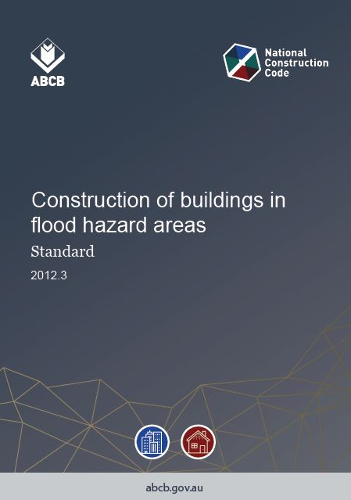
Referenced documents
Generally, the NCC references 3 specific types of standards:
Testing Standards
e.g. AS 1530 suite relates to the fire tests methods on building materials.
Design Standards
e.g. AS 1720 relates to the design methods for timber structures.
Installation Standards
e.g. AS 2050 relates to the installation of roof tiles.
Notes:
Generally, the NCC references 3 specific types of standards:
Testing Standards – for example, the AS 1530 suite relates to the fire tests methods on building materials.
Design Standards – for example, AS 1720 relates to the design methods for timber structures.
Installation Standards – for example, AS 2050 relates to the installation of roof tiles.
A full list of referenced documents can be found in Schedule 4 of each Volume of the NCC.

Slide 19
Example: DTS referenced document
0
Notes:
In this example, Australian Standard/ New Zealand Standard 3500.3 – Plumbing and drainage: Stormwater drainage ‐ is the DTS referenced standard for how to design and construct stormwater drainage.

Slide 20
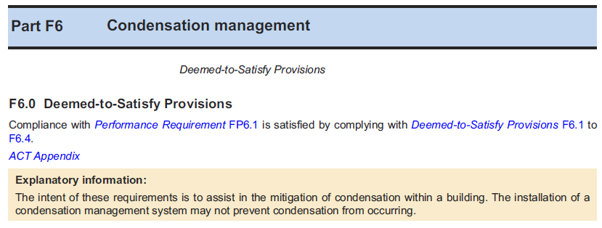
Explanatory information
Explanatory information – these are non-mandatory and informative only. They are used to provide additional guidance on the application of the particular Parts and clauses.
For example, Part F6.0 for Volume One contains explanatory information, as shown in the extract below.
Notes:
Explanatory information – these are non-mandatory and informative only. They are used to provide additional guidance on the application of the particular Parts and clauses.
For example, Part F6.0 for Volume One contains explanatory information. This information explains the intent of the Performance Requirement FP6.1 and the DTS Provisions in this Part, being to assist in the mitigation of condensation within a building.

Slide 21
Variations and additions to the NCC
Each State’s and Territory’s legislation adopts the NCC subject to the variation or deletion of some of its provisions, or the addition of extra provisions.
The three Volumes differ slightly in how they identify and represent variations and additions but generally they have some sort of ‘flag’ to highlight them.
State and Territory variations and additions for Volume One are located in the Appendices of Volume One.
Notes:
Each State’s and Territory’s legislation adopts the NCC subject to the variation or deletion of some of its provisions, or the addition of extra provisions.
Practitioners need to be aware of their State and Territory variations and additions as they form part of the NCC in that State or Territory.
The three Volumes differ slightly in how they identify and represent variations and additions but generally they have some sort of ‘flag’ to highlight them.
State and Territory variations and additions for Volume One are located in Schedule 1 of Volume One.

Slide 22
Section A: Governing Requirements
Building classifications
NCC Volume One (BCA) pertains primarily to Class 2 to 9 buildings.
Part A6 of Volume One contains the building classifications and descriptions.
The class – or classification – of a building/structure is determined by the purpose for which it is:
designed;
constructed; and
adapted to be used.
As the purpose of buildings vary there are different requirements for different classes.
Notes:
NCC Volume One (BCA) pertains primarily to Class 2 to 9 buildings. Part A6 of Volume One contains the building classifications and descriptions.
The class – or classification – of a building/structure is determined by the purpose for which it is:
designed;
constructed; and
adapted to be used.
As the purpose of buildings vary there are different requirements for different classes.

Slide 23
Section A: Governing Requirements
Building classifications
Class 2 - Dwellings/apartments
Class 3 - Hotels/motels
Class 4 - A single dwelling in a Class 5 to 9
Notes:
So let’s have a look at what the different classifications mean.
Class 2 buildings are generally residential apartment buildings
Class 3 buildings are hotels and motels.
Class 4 buildings are a single residential dwelling attached to either Class 5, 6, 7, 8 or 9 building. For example, think of a caretaker’s dwelling behind or above a retail shop – which would be a Class 6 building.

Slide 24
Section A: Governing Requirements
Building classifications
Class 5 - Offices – not Class 6 to 9
Class 6 - Retail shops
Class 7a - Carparks
Class 7b - Storage/display warehouse
Notes:
Class 5 buildings are offices – note these are not to be confused with Class 6 to 9 buildings.
Class 6 buildings are retail shops.
Class 7a are for carparking structures or buildings.
Class 7b buildings are storage and display warehouses.

Slide 25
Section A: Governing Requirements
Building classifications
Class 8 - Laboratory or factory
Class 9a - Health-care building
Class 9b - Assembly building such as schools and sports stadiums
Class 9c - Aged care building
Notes:
A Class 8 building would be a laboratory or factory.
A Class 9a building would be a health-care building, for example a hospital.
A Class 9b building is an assembly building such as a school or sports stadium.
A Class 9c building is an residential care building.
You will notice that there are a number of subclasses e.g. Class 7a, 7b, 9a, 9b and 9c. They are treated as separate classifications.
Note that additionally, Volume One also has provisions for Class 1b (small guest boarding houses) and 10a buildings; and 10b structures for access for people with disabilities.

Slide 26
Section B: Structure
Section B contains the structural provisions for buildings and structures.
The structural requirements of Section B apply generically.
The overall objective of Section B can be summarised as:
Safeguarding people and other property from the effects of a building suffering structural failure.
There are 2 Verification Methods in Section B.
The Deemed-to-Satisfy Provisions of Section B rely heavily on referenced documents.
Notes:
The next section of Volume One is Section B – Structure.
Section B contains the structural adequacy requirements for buildings and structures, and is applied generically to all building classifications covered by Volume One.
There are four Performance Requirements in Section B, BP1.1 to BP1.4. There are also two Verification Methods in Section B.
The overall objective of Section B can be summarised as ‐ safeguarding people and other property from the effects of a building suffering structural failure.
In doing this, the building or structure must be able to withstand any combination of loads and actions to which it may be reasonably subjected. These are listed in BP1.1 and cover actions such as permanent and imposed actions, wind action, snow action, earthquake action and so on.
The Deemed‐to‐Satisfy Provisions of Section B rely heavily on referenced documents and particularly design standards such as the AS/NZS 1170 suite and construction standards such AS 2050 and AS 1684.

Slide 27
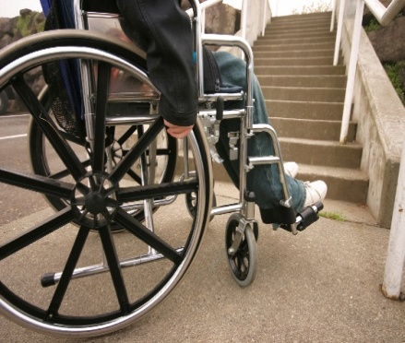
Sections C to J
Sections C to J contain requirements which are generally dependent on the specific class or building classification.
The requirements may also have limited application, dependent on other triggers such as the height of the building, floor area, number of people the building will accommodate, building layout etc.
Notes:
Unlike Section B which covers all buildings, Sections C to J contain specific building requirements which are generally dependent on the building classification, i.e. not all requirements apply to all designs.
The requirements may also have limited application, dependent on other triggers such as the height of the building, floor area, number of people the building will accommodate, building layout etc.

Slide 28
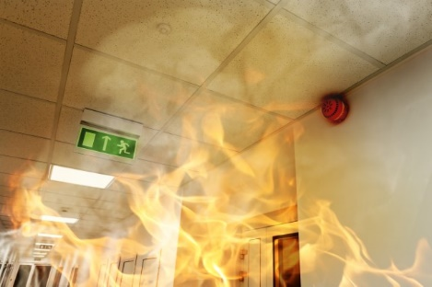
Section C: Fire resistance
Section C contains the fire resistance requirements for Class 2-9 buildings.
Key concepts in applying the requirements are:
Type of construction;
Rise in storeys; and
Fire compartmentation and separation.
Notes:
Section C of Volume One contains the fire resistance requirements for Class 2‐9 buildings.
In applying the Section C requirements it is critical to understand the following concepts which form the basis for applying the Volume One requirements for:
Type of construction;
Rise in storeys; and
Fire compartmentation and separation.
Section C also contains requirements for items such as: protection of openings in floors and ceilings, fire resistance levels (FRLs) of building elements, fire‐hazard properties for linings, materials and assemblies in buildings. However, to gain a basic understanding of the Section C requirements we will focus specifically on the key concepts i.e. Type of construction, rise in storeys and fire compartmentation and separation.

Slide 29
Section C: Fire resistance
Type of construction
The Type of construction required is dependant on the class of building and its rise in storeys.
Type A: most fire resistant – ‘non-combustible’ construction.
Type B: less fire resistant.
Type C: least fire resistant – ‘combustible’ construction.
Notes:
The first key concept in applying Section C is the type of construction required for a building.
As we can see from Table C1.1, the type of construction required is dependent on the class of building and its rise in storeys.
The Types of construction are used to determine the minimum type of fire‐resisting construction required for Class 2‐9 buildings.
Type A construction is the most fire resistant, Type C construction is the least fire resistant and Type B construction falls between these two.

Slide 30
Section C: Fire resistance
Rise in storeys
The rise in storeys generally means the number of storeys above natural ground level.
The rise in storeys is one criteria used to determine the type of construction.
Notes:
The second key concept is determining the ‘rise in storeys’ of a building.
Under C1.2, the rise in storeys is the sum of the greatest number of storeys at any part of the external walls of a building above ground level and any storeys within the roof space.
The rise in storeys is one criteria used to determine the type of construction. This is because the rise in storeys has an impact on:
The risk of exposure to radiant heat from a fire in another building;
The risk of emitting radiant heat to another building; and
The risk to occupants who may need to travel down a stairway to safely evacuate the building.
The figure shown on the slide is contained in the Guide to Volume One.

Slide 31
Section C: Fire resistance
Compartmentation and separation
The purpose of compartmenting buildings is to limit the size of any potential fire in a building.
This is achieved by placing general floor area and volume limitations on a compartment.
Notes:
The third key concept from Section C is the maximum fire compartment size.
Once we know the type of construction, we can then use that along with the Class of the building to determine the maximum allowable size of the fire compartments by reference to Table C2.2.
If the proposed building does not meet the criteria prescribed in C2.2, alternative options could include constructing the building of another type of construction, or for Class 5‐9 buildings the building may be designed in accordance with Part C2.3 which relates to large isolated buildings.
However, both of these are Deemed‐to‐Satisfy Solutions, and as you are aware the NCC is a performance‐based code. Therefore, the maximum allowable fire compartment requirements may potentially be addressed through formulating a Performance Solution to meet the relevant Performance Requirements.
However, doing this may have an effect on other parts of the NCC e.g. coverage of fire-fighting equipment, maximum travel distances, calculations for natural lighting and ventilation requirements, etc. This emphasises the importance of applying the NCC in a holistic manner.

Slide 32
Section D: Access and egress Objective
The Guide to Volume One states that:
“The Objective of this Section D to -
(a) provide, as far as is reasonable, people with safe, equitable and dignified access to -
(i) a building; and
(ii) the services and facilities within a building; and
(b) safeguard occupants from illness or injury while evacuating in an emergency.”
Notes:
The next Section of NCC Volume One, is Section D which contains the access and egress requirements for buildings and structures.
“The Objective of Section D is to:
a) provide, as far as is reasonable, people with safe, equitable and dignified access to:
i) a building; and
ii) the services and facilities within a building; and
b) safeguard occupants from illness or injury while evacuating in an emergency.”

Slide 33
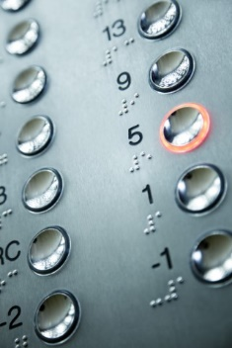
Section D: Access and egress Parts
Section D is divided into three Parts which are:
Part D1: Provision for escape;
Part D2: Construction of exits; and
Part D3: Access for people with a disability.
The disability access provisions in the NCC reflect the technical provisions in the Disability (Access to Premises - Buildings) Standards 2010.
Notes:
Section D: Access and egress, is broken into three Parts:
Part D1: Provisions for Escape;
Part D2: Construction of Exits; and
Part D3: Access for People with a Disability.
The disability access provisions in the NCC, reflect the requirements of the Disability (Access to Premises – Buildings) Standards (Premises Standards) made under the Commonwealth Disability Discrimination Act 1992 (DDA).
The Premises Standards were developed to address the gap between building law and the DDA and to provide certainty in relation to what levels of access to public buildings would satisfy the general non‐discrimination requirements of the DDA.
This results in a uniform set of requirements that will apply both in relation to non‐discriminatory access under the DDA and in relation to the requirements for access that must be complied with in order to obtain a building approval under building law.
The Premises Standard have been subjected to a 5 yearly review that commenced in 2015 and was complete in 2016. Amendments have been made to the BCA in response to this review.

Slide 34
Section D: Access and egress
Section D contains requirements for:
number of exits;
exit travel distances;
distance between exits;
discharge from exits;
fire isolated and non-fire isolated exits and stairs and ramps;
construction of exits;
stairways, balustrades, handrails;
width of doorways;
swing of doors and door latches; and
methods for determining the number of persons the building will accommodate.
Notes:
Section D relates to the requirements for number of exits required, exit travel distances and the construction of these exists, requirements for stairways, balustrades and handrails and methods for determining the number of persons the building will accommodate. It even has requirements for the way doors swing and the type of latches permitted!
Let’s take a moment to consider why the NCC would prescribe the maximum allowable travel distance to an exit.
The intent of D1.4 exit travel distances, is to enable occupants to be close enough to an exit to safely evacuate before conditions in the exit path become untenable during a fire, which in turn aligns with the goals of the NCC for minimum necessary standards of fire safety.

Slide 35
Section E: Services and equipment
Section E contains the requirements for services and equipment installations in buildings.
Section E is divided into four Parts, which are:
Part E1: Fire fighting equipment;
Part E2: Smoke hazard management;
Part E3: Lift installations; and
Part E4: Visibility in an emergency, exit signs and warning systems.
Notes:
The next section of the NCC Volume One, is Section E which contains the requirements for services and equipment installations in buildings.
There are four Parts to Section E, which are:
Part E1: Fire fighting equipment;
Part E2: Smoke hazard management;
Part E3: Lift installations; and
Part E4: Visibility in an emergency, exit signs, and warning systems.
The individual parts of Section E contain Performance Requirements.

Slide 36
Section E: Services and equipment Application
The application of the requirements of Section E may be dependent on the specific class or classes of buildings, or be dependent on other triggers such as the height of the building, floor area, and building use.
Notes:
The application of the Section E requirements may be dependent on the specific “Class or Classes” of buildings i.e. not all requirements apply to all designs.
This is particularly relevant for the Section E requirements as a number of the Deemed‐ to‐Satisfy Provisions have limited application, dependent on the height of the building, floor area, and the specific use of the building.

Slide 37
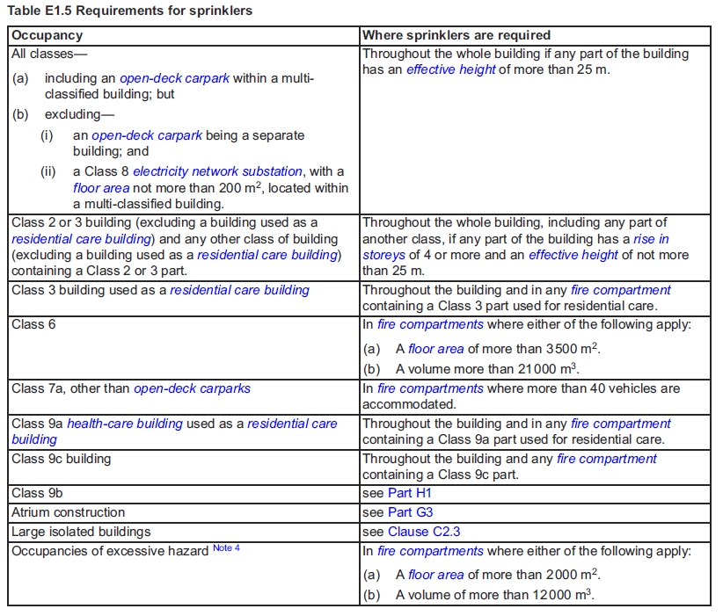
Section E: Services and equipment Application
The extract on the right of Table E1.5: Requirements for sprinklers, from Volume One provides an example of these requirements and the relevant triggers.
Notes:
So, let’s have a look at the extract from Table E1.5.
Generally the trigger for when a building is required to have fire sprinklers installed is when the building has an effective height of more than 25 meters, however, as can be seen in the extract from Table E1.5 there are also other triggers for when a building is required to have sprinklers installed.
For example:
for Class 2 or 3 buildings – excluding a residential care building - where the building has a rise in storeys of four or more and an effective height of not more than 25 metres;
for Class 6 buildings with floor areas exceeding 3,500 m² or volume greater than 21,000 m³; and
Class 7a – other than open deck carparks –where more than 40 vehicles are accommodated.
There are numerous other requirements for different building classifications.

Slide 38
Section F: Health and amenity
Section F contains the health and amenity requirements for Class 2-9 buildings.
Section F is divided into six Parts, which are:
Part F1: Damp and weatherproofing;
Part F2: Sanitary and other facilities;
Part F3: Room heights;
Part F4: Light and ventilation;
Part F5: Sound transmission and insulation; and
Part F6: Condensation management.
Notes:
The next section of the NCC Volume One is Section F, which contains the health and amenity requirements for Class 2‐9 buildings.
There are six Parts to Section F, which include:
Part F1: Damp and weatherproofing;
Part F2: Sanitary and other facilities;
Part F3: Room heights;
Part F4: Light and ventilation;
Part F5: Sound transmission and insulation; and
Part F6: Condensation management.
As with Section E, each Part of Section F has its own Performance Requirements.

Slide 39
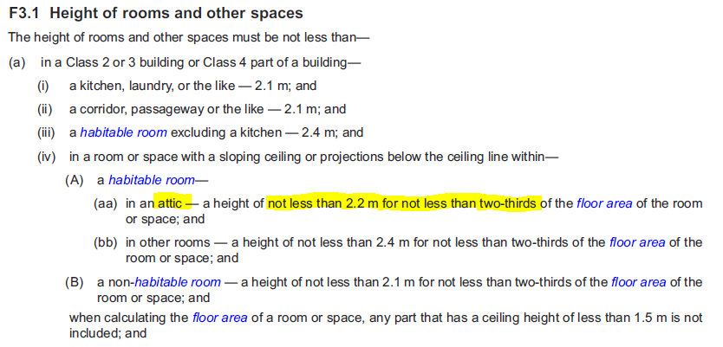
Section F: Health and amenity
Example: Room heights
Notes:
Section F covers a broad range of requirements from waterproofing of wet areas in buildings to issues such as determining how many toilets are required in a building or how much natural light or ventilation a room is required to have.
Let’s look at an example of applying the Section F requirements ‐ the minimum ceiling height in an attic.
As can be seen in the extract from the Deemed‐to‐Satisfy Provision F3.1, which prescribes the minimum ceiling height of rooms and other spaces, the ceiling height in an attic‐ must not be less than 2.2 m for not less than two thirds of floor area of the room.

Slide 40
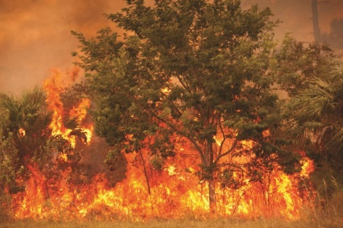
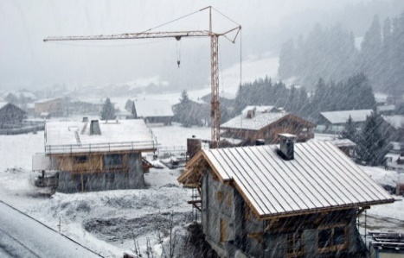
Section G: Ancillary provisions
Section G contains ancillary provisions for buildings and structures.
Section G is divided into six Parts which are:
Part G1: Minor structures and components;
Part G2: Boilers, pressure vessels, heating appliances, fireplaces, chimneys and flues;
Part G3: Atrium construction;
Part G4: Construction in alpine areas;
Part G5: Construction in bushfire prone areas; and
Part G6: Occupiable outdoor areas.
Notes:
Section G contains ancillary provisions for buildings and structures.
There are six Parts in Section G, which include:
Part G1: Minor structures and components;
Part G2: Boilers, pressure vessels, heating appliances, fireplaces, chimneys and flues;
Part G3: Atrium construction;
Part G4: Construction in alpine areas;
Part G5: Construction in bushfire prone areas; and
Part G6: Occupiable outdoor area.
As with Sections E and F, each Part of Section G has its own Performance Requirements.

Slide 41
Section H: Special use buildings
Section H contains the requirements for certain special use buildings
Section H contains Deemed-to-Satisfy Provisions which apply in addition to those contained in Sections C-F for:
theatres, stages and public halls;
public transport buildings; and
farm buildings and farm sheds.
Notes:
Section H contains some specific requirements for certain special use buildings, including:
theatres, stages and public halls;
public transport buildings; and
farm buildings and farm sheds.
This Section has Deemed‐to‐Satisfy Provisions which apply in addition to the requirements of Sections C to F.
The Performance Requirements for Section H are covered in the other sections of Volume One.

Slide 42
Section H: Special use buildings
Part H1 relates to requirements for theatres, stages and public halls.
Part H2 contains requirements for disability access in public transport buildings.
Part H3 includes requirements for fire separation and fire fighting equipment, exits and artificial lighting for farm buildings and farm sheds.
Notes:
Part H1 relates to the requirements for theatres, stages and public halls and contains provisions for things like fixed seating areas, aisle lights, and exits from theatres.
Part H2 contains requirements for disability access in public transport buildings. Specifically Part H2 relates to buildings associated with public transport services, such as railway stations, bus interchanges and ferry terminals.
Part H3 includes requirements for fire separation, fire fighting equipment, exits and emergency lighting for farm buildings and farm sheds.

Slide 43
Section J: Energy efficiency
The Objective of this Section, as per JO1 in the Guide to Volume One, is to reduce greenhouse gas emissions.
This Objective reflects the Council Of Australian Governments (COAG) decision in 2009 that a building is to be capable of reducing its greenhouse gas emissions.
Notes:
Section J is the final Section of NCC Volume One. This contains the energy efficiency requirements for buildings and structures.
The objective of this Section, as per JO1 in the Guide to Volume One, is to reduce greenhouse gas emissions.
This reflects the Council of Australian Governments (COAG) decision in 2009 that a building is to be capable of reducing its greenhouse gas emissions.

Slide 44
Section J: Energy efficiency
Section J is divided into seven Parts, which are:
Part J0: Energy efficiency;
Part J1: Building fabric;
Part J3: Building sealing;
Part J5: Air-conditioning and ventilation systems;
Part J6: Artificial lighting and power;
Part J7: Heated water supply and swimming pool and spa pool plant; and
Part J8: Facilities for energy monitoring.
Notes:
There are seven Parts of Section J, which are:
Part J0: Energy efficiency – outlines how to apply the Deemed-to-Satisfy Provisions of Section J;
Part J1: Building fabric - Insulation to the building fabric (roof, walls and floor), and measures to control unwanted heat gain or loss through glazing and roof lights;
Part J3: Building sealing - Measures to reduce air leakage (infiltration) through penetrations of the building fabric;
Part J5: Air‐conditioning and ventilation systems – Minimum efficiency levels and energy use for equipment providing services such as heating, ventilation and air conditioning;
Part J6: Artificial lighting and power - Minimum efficiency levels and energy sources for lighting;
Part J7: Heated water supply and swimming pool and spa pool plant - Measures affecting heating and pumping and covers for swimming pools and spas; and
Part J8: Facilities for energy monitoring – Requirements for monitoring energy consumption.
It should be noted that the content of Parts J2 and J4 which existed in previous editions of Volume One, have been removed. The Part number has been retained so as not to change the numbering from previous editions. The content of the previous Part J2 has been absorbed into Part J1.

Slide 45
Guide to NCC Volume One
The Guide to NCC Volume One provides additional and non-mandatory explanatory information.
The Guide is used to provide additional guidance on the application of the particular Parts, clauses and defined terms.
The Guide is integrated into NCC Volume One online at ncc.abcb.gov.au.
Notes:
For NCC Volume One, additional explanatory information is provided in the Guide to Volume One.
The Guide is non‐mandatory and is used to provide additional guidance on the application of the particular Parts, clauses, and defined terms.
The Guide is integrated into NCC Volume One online at ncc.abcb.gov.au.

Slide 46
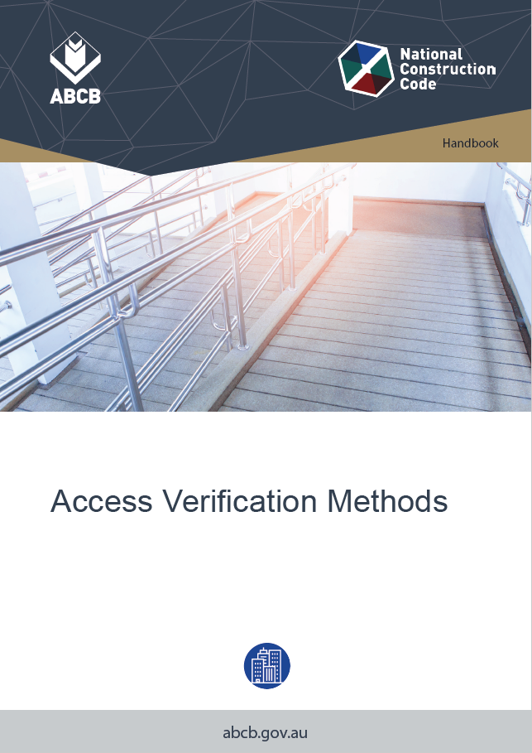
Handbooks
The ABCB has produced a number of non‐mandatory handbooks, which provide additional background and explanatory information in relation to NCC Volume One. These include:
Lifts used during evacuation;
Construction of buildings in flood hazard areas;
Sound insulation; and
Energy Efficiency Provisions for Volume One.
All handbooks can be found at the ABCB website at abcb.gov.au.
Notes:
The ABCB has produced a number of non‐mandatory handbooks, which provide additional background and explanatory information in relation to NCC Volume One. Some of these include:
Lifts used during evacuation;
Construction of buildings in flood hazard areas;
Sound insulation; and
Energy Efficiency Provisions for Volume One.
All handbooks can be found at the ABCB website at abcb.gov.au.

Slide 47
Conclusion
Upon completion, you will have acquired:
an overview of NCC Volume One, with particular emphasis on the application; and
an appreciation of the various Sections within Volume One.
Notes:
Upon completion, you’ll have acquired:
an overview of NCC Volume One, including its application; and
an appreciation of the various Sections within Volume One.

Slide 48
Assessment Questions
Answers are indicated in red.
Question 1
The NCC applies to building, plumbing and drainage solutions for:
New construction
Additions and alterations
Change of use
All of the above
Question 2
Volume One of the NCC contains:
The design and construction requirements for Class 2-9 buildings
Plumbing and drainage requirements for plumbing associated with all building classifications
The design and construction requirements for houses.

Slide 49
Assessment Questions (continued)
Question 3
What Class of building would an office building be?
9b
3
6
5.
Question 4
The Performance Requirements can be met through using either:
A Performance Solution
A Deemed-to-Satisfy Solution
A combination of both
All of the above.

Slide 50
Assessment Questions (continued)
Question 5
True or false? By using the Deemed-to-Satisfy Provisions of Sections B-J in accordance with Section A, the solution will automatically achieve compliance with the corresponding Performance Requirements.
True
False.
Question 6
True or false? Some Performance Requirements contain limitations which specify the application of the Performance Requirement.
True
False.

Slide 51
Assessment Questions (continued)
Question 7
The key concepts in applying Section C requirements are:
Structural adequacy, resistance to moisture, indoor air quality
Conditioned spaces, climate zone, building envelope
Type of construction, rise in storeys, structural adequacy
Type of construction, rise in storeys, fire compartmentation and separation.
Question 8
For a 3 storey Class 9 building, according to Table C1.1 of NCC Volume One, what type of construction would be required?
Type A
Type B
Type C.

Slide 52
Assessment Questions (continued)
Question 9
The rise in storeys has an impact on:
The risk of exposure to radiant heat from a fire in another building
The risk of emitting radiant heat to another building
The risk of occupants who may need to travel down a stairway to safely evacuate the building
All of the above.
Question 10
What Class of building would the Sydney Olympic Stadium be?
9a
9b
9c
8.

Slide 53
Assessment Questions (continued)
Question 11
The only trigger for the installation of fire sprinklers in buildings is where the building is greater than 25m in effective height?
Yes
No.
Question 12
The purpose of the Guide to Volume One is to:
Provide background and explanatory information
Provide assistance in understanding relationships between different parts of Volume One
Provide assistance when interpreting Volume One
All of the above.

Slide 54
Copyright, Attribution & Disclaimer
Copyright
© Commonwealth of Australia and the States and Territories of Australia 2020, published by the Australian Building Codes Board.
The material in this publication is licensed under a Creative Commons Attribution—4.0 International licence, with the exception of: any third party material, any trademarks, and any images or photographs. More information on this CC BY licence is set out at the Creative Commons Website. Enquiries about this publication can be sent to: Australian Building Codes Board ,GPO Box 2013, CANBERRA ACT 2601. Phone: 1300 134 631, Email: ncc@abcb.gov.au www.abcb.gov.au.
Attribution
Use of all or part of this publication must include the following attribution:
© Commonwealth of Australia and the States and Territories 2020, published by the Australian Building Codes Board.
Disclaimer
By accessing or using this publication, you agree to the following:
While care has been taken in the preparation of this publication, it may not be complete or up-to-date. You can ensure that you are using a complete and up-to-date version by checking the Australian Building Codes Board website (www.abcb.gov.au).
The Australian Building Codes Board, the Commonwealth of Australia and States and Territories of Australia do not accept any liability, including liability for negligence, for any loss (howsoever caused), damage, injury, expense or cost incurred by any person as a result of accessing, using or relying upon this publication, to the maximum extent permitted by law. No representation or warranty is made or given as to the currency, accuracy, reliability, merchantability, fitness for any purpose or completeness of this publication or any information which may appear on any linked websites, or in other linked information sources, and all such representations and warranties are excluded to the extent permitted by law.
This publication is not legal or professional advice. Persons rely upon this publication entirely at their own risk and must take responsibility for assessing the relevance and accuracy of the information in relation to their particular circumstances.

