Slide 1
Alt text
Volume One: Disability Access
Insert Corporate logo here
ALT text
© Commonwealth of Australia and the States and Territories of Australia 2020, published by the Australian Building Codes Board.
Notes:
NCC Essentials – NCC Volume One Disability Access
The following notice does not form part of the NCC Essentials script.
Copyright
© Commonwealth of Australia and the States and Territories of Australia 2020, published by the Australian Building Codes Board.
The material in this publication is licensed under a Creative Commons Attribution—4.0 International licence, with the exception of: any third party material, any trademarks, and any images or photographs. More information on this CC BY licence is set out at the Creative Commons Website. Enquiries about this publication can be sent to:
Australian Building Codes Board ,GPO Box 2013, CANBERRA ACT 2601
Phone: 1300 134 631
Email: ncc@abcb.gov.au www.abcb.gov.au
Attribution
Use of all or part of this publication must include the following attribution:
© Commonwealth of Australia and the States and Territories 2020, published by the Australian Building Codes Board.
Disclaimer
By accessing or using this publication, you agree to the following:
While care has been taken in the preparation of this publication, it may not be complete or up-to-date. You can ensure that you are using a complete and up-to-date version by checking the Australian Building Codes Board website (www.abcb.gov.au).
The Australian Building Codes Board, the Commonwealth of Australia and States and Territories of Australia do not accept any liability, including liability for negligence, for any loss (howsoever caused), damage, injury, expense or cost incurred by any person as a result of accessing, using or relying upon this publication, to the maximum extent permitted by law. No representation or warranty is made or given as to the currency, accuracy, reliability, merchantability, fitness for any purpose or completeness of this publication or any information which may appear on any linked websites, or in other linked information sources, and all such representations and warranties are excluded to the extent permitted by law.
This publication is not legal or professional advice. Persons rely upon this publication entirely at their own risk and must take responsibility for assessing the relevance and accuracy of the information in relation to their particular circumstances.

Slide 2
Table of contents
Introduction
How it works
What you’ll learn.
Contents
Applying the NCC
Overview of relevant NCC Volume One disability access requirements including:
Section D
Verification Methods for Section D: Access and Egress
Accessible adult change facilities.
Summary
Notes:
The introduction will cover how it works and what you’ll learn.
The contents include applying the NCC and an overview of the relevant NCC Volume One disability access requirements.
These include Verification Methods in Section D: Access and egress and accessible adult change facilities.

Slide 3
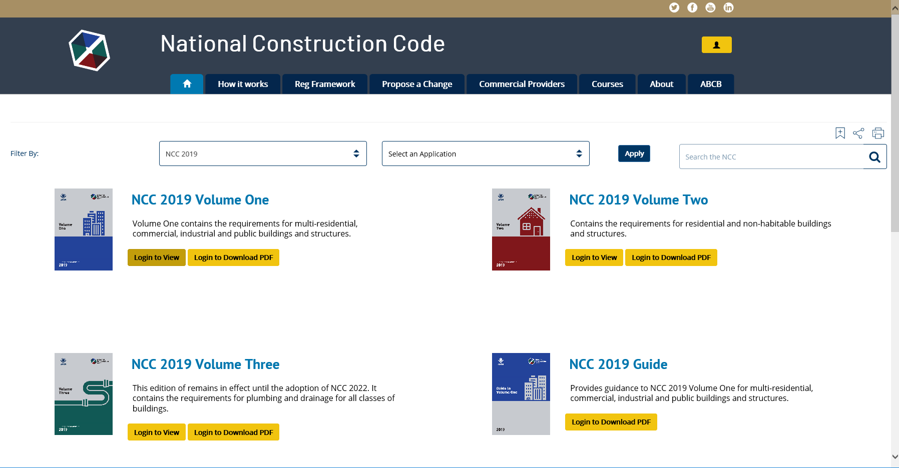
How to access the NCC
To access the NCC, visit: ncc.abcb.gov.au
To access the NCC, register your details here, submit and receive your confirmation email and password
Notes:
The NCC is freely available online via the ABCB website. First time users should select the Register option (top right of the ABCB home page). Once registered, users are sent a confirmation email that allows access to the NCC online and in downloadable PDF format.

Slide 4
What you will learn
Aims & Objectives
To provide you with a basic understanding of the NCC Volume One disability access requirements.
Who this material is for
All building professionals.
Notes:
The aim is to provide you with a basic understanding of the NCC Volume One disability access requirements.
This material is designed for all building professionals.

Slide 5
Overview of the NCC
The role of the NCC is to provide:
nationally consistent minimum necessary regulations; and
a technical basis for the design and construction of buildings and certain structures.
There are three performance-based volumes in the NCC, namely:
the Building Code of Australia (BCA) (NCC Volumes One and Two); and
the Plumbing Code of Australia (PCA) (NCC Volume Three).
Notes:
Let’s begin with a brief overview of the NCC.
The National Construction Code (or NCC) is an initiative of the Council of Australian Governments to incorporate all on-site construction requirements into a single code. Its role is to provide nationally consistent minimum necessary regulations and a technical basis for the design and construction of buildings and certain structures throughout Australia.
There are three volumes currently in the NCC and all three are performance-based.
The Building Code of Australia or ‘BCA’, makes up Volumes One and Two of the NCC.
Volume One pertains primarily to Class 2 to 9 buildings.
Volume Two pertains primarily to Class 1 and 10 buildings.
Volume Three of the NCC is the Plumbing Code of Australia or ‘PCA’. This pertains primarily to plumbing and drainage associated with all classes of buildings.
Generally, the NCC applies to the construction of new buildings and new building work in existing buildings. The NCC also applies to the change of use of a building.
The NCC takes effect as a regulatory document through its adoption by state and territory legislation.

Slide 6
NCC Volume One
Contains the design and construction requirements for Class 2 to 9 buildings, and certain requirements for Class 1b, 10a and 10b buildings and structures.
Class 2 to 9 buildings are generally commercial, industrial, multi-residential, and institutional buildings.
Volume One contains 9 distinct Sections (A to J).
Volume Three contains some specific requirements for accessible plumbing fittings and fixtures.
Notes:
Now let’s look at Volume One in greater detail.
Volume One of the NCC contains the design and construction requirements for Class 2 to 9 buildings. Although matters regarding Class 1 and 10 buildings are primarily in NCC Volume Two, certain requirements for Class 1b, 10a buildings (e.g. public toilets in parks) and 10b swimming pools are contained in Volume One.
Class 2 to 9 buildings are generally commercial, industrial, multi-residential, and institutional buildings.
Volume One contains 9 distinct Sections (A to J) covering various building elements.
These requirements cover matters such as structure, fire resistance, access and egress, services and equipment, and energy efficiency as well as certain aspects of health and amenity.
The NCC disability access requirements are primarily contained in Volume One, however, Volume Three also contains some specific requirements for accessible plumbing fittings and fixtures.

Slide 7
NCC Compliance Structure
Notes:
The NCC is a performance-based code. This means that to comply with the NCC, practitioners need to meet the Performance Requirements. Compliance with the Performance Requirements is achieved in a few different ways; by using a Performance Solution, a Deemed-to-Satisfy Solution, or a combination of both.
The top level - the Performance Requirements - is the compliance level. The bottom level are the compliance solutions, which are Performance Solutions or Deemed-to-Satisfy Solutions.

Slide 8
Performance Solutions
The performance-based NCC allows for flexibility in how compliance is achieved.
Performance Solutions give designers the flexibility to do things differently, potentially providing a more cost effective design and improving constructability.
Performance Solutions would need to provide a level of access and amenity that meet the relevant Performance Requirements.
Notes:
The performance-based NCC allows for flexibility in how compliance with the Performance Requirements is achieved. Therefore, if a designer chooses not to design a building or part of a building in accordance with the Deemed-to-Satisfy Provisions, this is allowed through the formulation of a Performance Solution.
A Performance Solution is a solution that complies with the Performance Requirements by means other than the Deemed-to-Satisfy Provisions. Performance Solutions give designers the flexibility to do things differently from the Deemed-to-Satisfy Provisions, potentially providing a more cost effective design and improving constructability.
In formulating Performance Solutions, designers need to ensure that the solution would provide a level of access and amenity that meet the relevant Performance Requirements.

Slide 9
NCC Volume One: Relevant Sections
For disability access in NCC Volume One, they are:
Section A: how to use the NCC, including building classifications;
Section D: access and egress requirements for buildings; and
Parts E3, F2 and H2: some specific requirements (e.g. lifts and accessible sanitary facilities).
Notes:
The relevant sections for the disability access requirements in NCC Volume One are:
Section A: This contains the mandatory Governing Requirements. The Governing Requirements provide the rules and instructions for using and complying with the NCC;
Section D: This contains the access and egress requirements for buildings. The NCC disability access requirements are primarily contained in this Section; and
Parts E3, F2 and H2: These parts contain some specific requirements for matters such as lifts and accessible sanitary facilities.
For simplicity, where it refers to the ‘NCC access requirements' in this material, it is intended to mean the NCC disability access requirements.

Slide 10
Background of the Access Provisions
In this section we will look at:
Background and objectives of the NCC disability access requirements; and
The relationship with:
the Disability Discrimination Act 1992; and
the Disability (Access to Premises - buildings) Standards 2010.
Notes:
In this section we will take a brief look at the:
background and objectives of the NCC disability access requirements; and
the relationship between the Disability Discrimination Act (DDA) 1992 and the Disability (Access to Premises- Buildings) Standards 2010 (the Premises Standards) and the NCC Disability Access requirements.
As with other parts of the NCC, understanding the intent of these requirements will greatly assist in ensuring the correct application of the code.

Slide 11
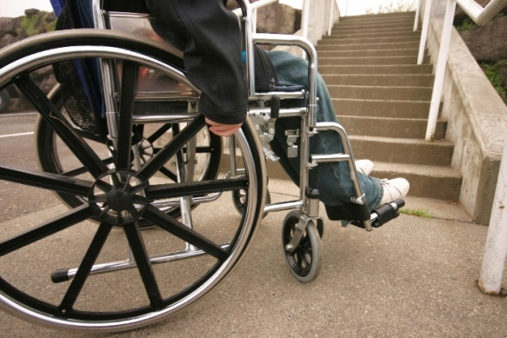
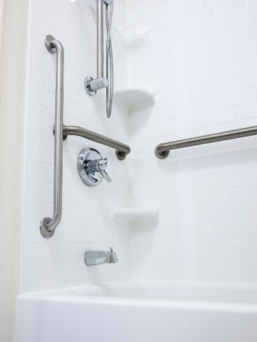
Disability
A broad definition of disability includes people who:
are blind or have low vision;
have learning or intellectual disabilities;
are deaf or hearing-impaired;
have a physical disability;
experience mental health or psychological difficulties; and
have an acquired brain injury.
Notes:
It is important to have a clear appreciation of the definition of people with disability. The definition of disability shown here is used in anti-discrimination law, not the NCC. It is very broad and covers about 20% of Australians.
People protected from discrimination by those laws may experience difficulties using buildings, so buildings need to be designed and constructed in ways to ensure they are accessible. It's not just people with a mobility disability who experience barriers to accessing and using buildings.
Two examples of how disability can affect building design are:
a person with low vision might experience difficulty using poorly designed stairs, and
a person with a hearing impairment might experience difficulty hearing a bank teller behind a fully screened counter.
Good access has benefits for a much wider group of people than those who currently have a disability. For example, those of us who will have a disability in the future, families with small children, the elderly and anyone delivering or picking up goods, all benefit from good access to buildings.

Slide 12
Background
Disability access requirements have been in the BCA since 1990.
Focus has primarily been on access to commercial and public buildings i.e. Class 3 and 5-9 buildings.
Notes:
Disability access requirements are not new to the NCC. Requirements have been in the BCA since 1990. Some of the issues covered in the current NCC remain very similar to previous requirements.
These requirements primarily focus on commercial and public buildings, i.e. Class 3 and 5-9 buildings, rather than private housing. However, the NCC contains some disability access requirements for certain Class 1b and Class 10 buildings and structures, and to certain parts of Class 2 buildings.

Slide 13
Objectives and Application of the NCC Access Provisions
Overall access objectives
To provide, as far as is reasonable, people with safe, equitable and dignified access to:
a building, and
the services and facilities within a building.
The NCC only addresses the physical fabric and layout of a building. It does not address:
fixtures and fittings;
wayfinding information; or
management policies.
Notes:
The NCC sets out how to provide safe, equitable and dignified access to buildings. Good design is not just about providing some access.
The overall access objective is about ensuring, as much as possible, that people with disability can use buildings independently and with dignity.
The overall access objectives are to provide, as far as is reasonable, people with safe, equitable and dignified access to:
a building, and
the services and facilities within a building.
Examples of adhering to the access principles include:
accessible entry to a new building must be the principal pedestrian entrance and not one around the back of the building; and
gaining access to a swimming pool should not rely on someone having to be carried into it.
The NCC is mainly concerned with the physical construction of the building. Generally speaking, what happens after construction in terms of fit out and ongoing use and management are not covered by the NCC, but continue to be covered by discrimination law.
It is important to understand that the NCC does not address three areas:
fixtures and fittings used in a building, such as furniture or reception desks;
wayfinding information, such as room numbers or general information signs; and
management policies or staff behaviour – for example: if the staff at a nightclub refuse to allow a blind person entry.

Slide 14
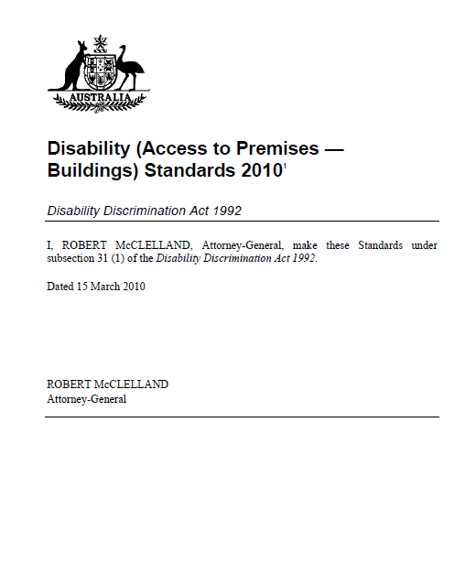
Relationship with the DDA and Premises Standards
The NCC access provisions reflect the requirements of the Premises Standards made under the Commonwealth Disability Discrimination Act 1992 (DDA).
The Premises Standards were developed to provide certainty in relation to what levels of access to public buildings would satisfy the general non-discrimination requirements of the DDA.
Results in a uniform set of requirements.
Notes:
Although the BCA has had access requirements since 1990 there were inconsistencies between the BCA requirements and the Commonwealth Disability Discrimination Act 1992, (DDA). This led to uncertainty for the building industry including developers, designers, builders and certifiers.
As a consequence there had been a number successful DDA complaints about buildings which were BCA compliant. One example is: Cocks v the State of Queensland 1994, where a complaint was made against the Brisbane Convention Centre. The cost of rectification was in the order of $300,000. In 2018, this would be approximately $537,000.
To address the inconsistencies between building law and the DDA, the Commonwealth Government resolved to develop a disability standard covering buildings, which would form part of the BCA when completed. The BCA was updated in 2011 as a result.
The NCC access provisions reflect the requirements of the Disability (Access to Premises – Buildings) Standards 2010, known as the Premises Standards. The Premises Standards were developed to provide certainty in relation to what levels of access to public buildings would satisfy the general non-discrimination requirements of the DDA.
This results in a uniform set of requirements that apply both in relation to non-discriminatory access under the DDA and in relation to the requirements for access that must be complied with in order to obtain a building approval under building law.

Slide 15
Relationship with the DDA and Premises Standards
The Premises Standards comprise:
Parts 1 – 6 including trigger dates and objectives, scope, exceptions and concessions and review provisions; and
Access Code for Buildings which provides the Performance Requirements and Deemed-to-Satisfy Provisions.
Notes:
The Premises Standards comprise two sections.
The first section consists of six parts which cover legal and administrative issues including some general concessions and exemptions and review provisions.
The second part is the Access Code for Buildings. This is the part that includes Performance Requirements and Deemed-to-Satisfy Provisions which give the technical detail on how to comply.
Those familiar with the NCC will recognise that the Access Code is written in the same style as the NCC.

Slide 16
NCC Disability Access requirements
In this section we will look at relevant:
defined terms;
referenced documents;
Performance Requirements;
Verification Methods; and
Deemed-to-Satisfy Provisions.
Notes:
In this section we will look at the NCC Disability Access requirements in more detail including relevant:
defined terms;
NCC referenced documents;
Performance Requirements;
Verification Methods; and
Deemed-to-Satisfy Provisions.

Slide 17
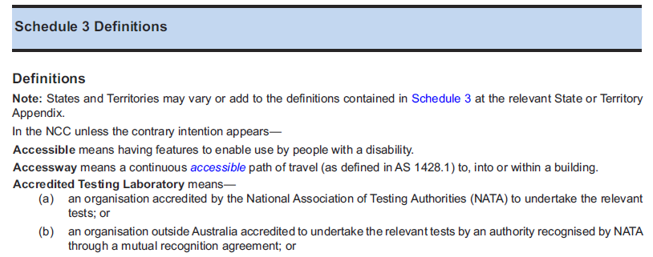
Defined Terms
Notes:
Schedule 3 of Volume One contains NCC defined terms.
Whilst we won’t go through each individual term or referenced document we will look at those relevant to applying the access provisions. Relevant referenced documents and building classifications will be covered later.
In the NCC, terms are specifically defined appear in italics to alert users that a special meaning has been ascribed.
Two key definitions in relation to applying the NCC access requirements are accessible and accessway.
In the NCC, something is accessible if it has features that ensure people with disability can get into and use a building. Whereas, accessway is defined as - a continuous accessible path of travel to, into or within a building.

Slide 18
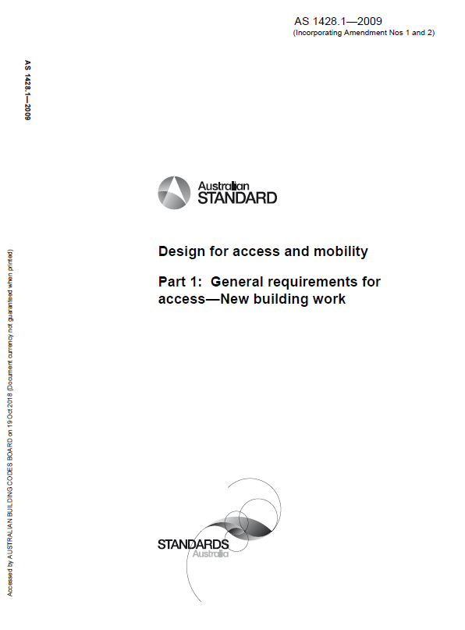
Referenced Documents
The NCC itself does not contain details of every design and construction requirement for a building or plumbing or drainage system.
It calls upon or ‘references’ other documents called NCC referenced documents.
They are adopted as Deemed-to-Satisfy means of complying with Performance Requirements.
They are listed in Schedule 4 of the NCC. Examples include Australian Standards, ABCB protocols, ABCB standards and other publications.
The NCC also takes precedence over any referenced document.
Notes:
The NCC itself does not contain details of every design and construction requirement for a building or plumbing or drainage system.
As such, the NCC calls upon or ‘references’ other documents with this information. These are called NCC referenced documents. They are adopted as Deemed-to-Satisfy means of complying with Performance Requirements.
Referenced documents are listed in Schedule 4 of the NCC. Examples include Australian Standards, ABCB protocols, ABCB standards and other publications.
The NCC also takes precedence over any referenced document.

Slide 19
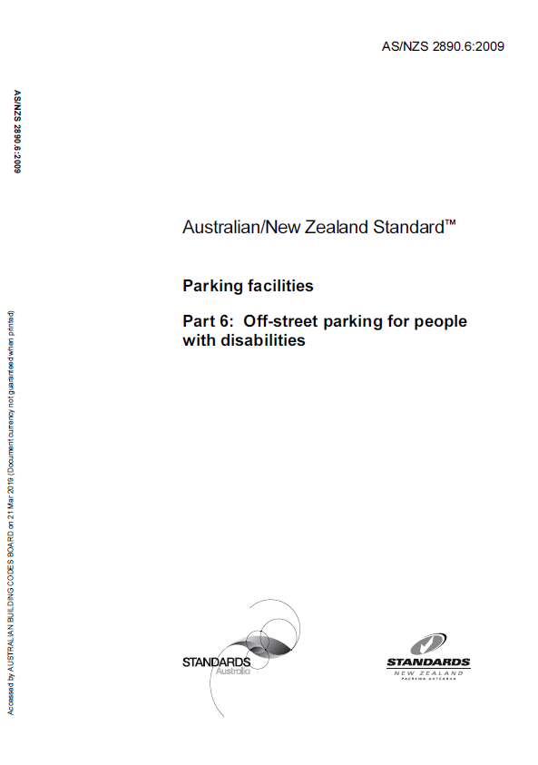
Referenced Documents
AS 1428.1: Design for access and mobility, Part 1 – General requirements for access – New building work
Contains technical information on the construction of accessways, for example:
dimensions and clearances at doorways;
design of handrails; and
layout of accessible toilets.
Other relevant Australian Standards include:
AS/NZS 2890.6: Parking facilities - Off-street parking for people with disabilities; and
AS 1428.4.1: Design for access and mobility - Means to assist the orientation of people with vision impairment - Tactile ground surface indicators.
Notes:
Australian Standard 1428.1 (Design for access and mobility, Part 1 – General requirements for access – New building work) is a key reference in applying the NCC access provisions. AS 1428.1 contains most of the technical information necessary to ensure the Deemed-to-Satisfy Provisions are met.
Other relevant Australian Standards include:
AS/NZS 2890.6 for accessible carparking, and
AS 1428.4.1 for specifications for tactile ground surface indicators.
In order to fully understand the application of the Deemed-to-Satisfy Provisions of the NCC, a building must meet the requirements of Parts D3, E3, F2 and H2 and the technical specifications in referenced Australian Standards.

Slide 20
Performance Requirements
Key Performance Requirements relating to disability access:
DP1 Access for people with a disability
DP2 Safe movement to and within a building
DP4 Exits
DP6 Paths of travel to exits
DP7 Evacuation lifts
DP8 Carparking for people with a disability
DP9 Communication systems for people with hearing impairment
EP3.4 Lift access for people with a disability
FP2.1 Personal hygiene facilities
Notes:
Next we'll look at the key Performance Requirements of the NCC relating to disability access.
Performance Requirements relating to disability access are primarily in Section D, although there are also ones in Section E and Section F.
You'll note there's no relevant Performance Requirement listed for Section H; this is because Performance Requirements for this section are covered in the other sections of the NCC.
Remember within the ‘Compliance Structure of the NCC’ the Performance Requirements are mandatory and set the levels of performance that must be met.

Slide 21
Performance Requirements
The Performance Requirements seek to ensure buildings provide a ‘continuous accessible path of travel’.
Access is required to most spaces and facilities within a building used by the occupants - who may be customers, visitors or staff.
Notes:
In broad terms, the Performance Requirements seek to ensure buildings provide a ‘continuous accessible path of travel’ i.e. one that does not include features that might impede safe, equitable and dignified movement and access to facilities.
Access is required:
to a building from the allotment boundary;
between associated buildings that are required to be accessible;
between levels (via lifts, ramps and stairs);
in most buildings, to all areas normally used by the occupants;
to signage including braille and tactile;
to hearing augmentation systems; and
to suitable sanitary facilities.
While there are some exceptions and exemptions within the NCC, access is required to most spaces and facilities within a building used by the occupants - who may be customers, visitors or staff.
It is important to note however, that because Volume One applies to a broad range of buildings – for example, commercial, industrial, multi-residential, and institutional buildings - some Performance Requirements may have limited application, generally dependent on the specific “Class or Classes” of building - i.e. not all requirements apply to all designs.

Slide 22
Example: Performance Requirements
Notes:
Let’s take a look at one of the relevant Performance Requirements.
Performance Requirement DP6 addresses safe evacuation of a building and requires that the design of paths of travel to exits be appropriate, taking into consideration the use of a building, the number of occupants and the mobility of occupants.
For example, a hospital will require appropriately designed paths of travel to exits taking into account that occupants are likely to have limited mobility or capacity to find their way unassisted.

Slide 23
Assessing Performance Solutions
A2.2 states that Performance Solutions will only comply with the NCC when the Assessment Method/s used demonstrate compliance with Performance Requirements.
A2.2(2) describes the four Assessment Methods that can be used to demonstrate compliance.
Designers should discuss which Assessment Method should be used with the Approval Authority prior to proceeding with developing a detailed Performance Solution.
A Deemed-to-Satisfy Solution can also be used to comply with the Performance Requirements. Refer to A2.3 for further details.
Notes:
In Volume One, A2.2 establishes that an Assessment Method must be used to demonstrate that a Performance Solution complies with the NCC.
Practitioners must ensure that an appropriate Assessment Method is used.
On the basis that the respective Approval Authority will direct the approval of a Performance Solution, it's beneficial for designers to obtain their view on A2.2 prior to proceeding with developing a detailed Performance Solution.
An Assessment Method must also be used to demonstrate that a DTS Solution complies with the Performance Requirements. Refer to A2.3 for further details.

Slide 24
Types of Assessment Methods for Performance Solutions
There are four Assessment Methods in the NCC that can be used to demonstrate the compliance of a Performance Solution with the relevant Performance Requirements. These are:
Evidence of suitability;
Verification Methods;
Expert Judgement; and
Comparison to Deemed-to-Satisfy Provisions.
The Assessment Methods are listed in Part A2 of the Governing Requirements of each Volume of the NCC.
Verification Method
Evidence of suitability
AND / OR
Comparison with DTS Provisions
Expert Judgement
Notes:
Assessment Methods for Performance Solutions are listed in Part A2 of the Governing Requirements across all three Volumes of the NCC.
There are four Assessment Methods:
Evidence of Suitability;
Verification Methods;
Expert Judgement; and
Comparison with the Deemed-to-Satisfy Provisions.

Slide 25
Verification Methods
Verification Method (VM) is a NCC defined term. It is defined as:
a test, inspection, calculation, or other method that determines whether a Performance Solution complies with the relevant Performance Requirements.
A practitioner can use a VM within the NCC, or a VM which is not in the NCC.
There are a number of NCC Verification Methods for disability access. In Section D, there are two:
DV2: Access to and within a building; and
DV3: Ramp gradient, crossfall, surface profile and slip resistance for ramps used by wheelchairs.
Notes:
Verification Method (VM) is a defined term. It is defined as:
a test, inspection, calculation, or other method that determines whether a Performance Solution complies with the relevant Performance Requirements.
A practitioner can use a VM within the NCC, or a VM which is not in the NCC.
There are a number of relevant NCC Verification Methods for disability access. In Section D, there are two:
DV2: Access to and within a building; and
DV3: Ramp gradient, crossfall, surface profile and slip resistance for ramps used by wheelchairs.

Slide 26
Deemed-to-Satisfy Provisions
A Deemed-to-Satisfy Solution, which complies with the Deemed-to-Satisfy Provisions is deemed to comply with the Performance Requirements.
Compliance with the Deemed-to-Satisfy Provisions ensures compliance with the Access Code of the Premises Standards.
The Deemed-to-Satisfy Provisions related to disability access are contained in four Parts:
Part D3: covers general building access requirements
Part E3: covers lifts
Part F2: covers accessible sanitary facilities including adult change facilities
Part H2: covers requirements for public transport buildings.
Notes:
The Deemed-to-Satisfy Provisions in the NCC describe one way of meeting the Performance Requirements. If a builder, designer or the like, chooses a Deemed-to-Satisfy Solution that complies with the Deemed-to-Satisfy Provisions it will automatically achieve compliance with the corresponding Performance Requirements.
As mentioned earlier, compliance with the Deemed-to-Satisfy Provisions in the NCC ensures compliance with the Access Code of the Premises Standards.
The relevant Deemed-to-Satisfy Provisions related to disability access are contained in four Parts:
Part D3: covers general building access requirements
Part E3: covers lifts
Part F2: covers sanitary facilities including the requirement for adult change facilities
Part H2: covers requirements for public transport buildings.
It is important to note that the Deemed-to-Satisfy Provisions provide a number of concessions and exemptions that define some limits to the level of access required in specific buildings or areas of buildings.

Slide 27
Deemed-to-Satisfy Provisions Part D3: Access for people with a disability
D3.1 – General building access requirements
D3.2 – Access to buildings
D3.3 – Parts of buildings to be accessible
D3.4 – Exemptions
D3.5 – Accessible carparking
D3.6 – Signage
D3.7 – Hearing augmentation
D3.8 – Tactile indicators
D3.9 – Wheelchair seating spaces in Class 9b assembly buildings
D3.10 – Swimming pools
D3.11 – Ramps
D3.12 – Glazing on an accessway
Specification D3.6 – Braille and tactile signs
Specification D3.10 – Accessible water entry/exit for swimming pools
Notes:
Part D3 contains the following provisions:
D3.1 – sets out the general building access requirements.
D3.2 – specifies the extent of access that must be provided to buildings.
D3.3 – specifies requirements for accessways within buildings.
D3.4 – provides a number of exemptions for providing access.
D3.5 – specifies the number of accessible carparking spaces required and their specifications.
D3.6 – specifies requirements for accessible signage.
D3.7 – specifies requirements for hearing augmentation systems.
D3.8 – specifies requirements for tactile indicators to assist blind or vision impaired people to avoid hazardous situations.
D3.9 – specifies requirements for wheelchair seating spaces in Class 9b assembly buildings.
D3.10 – specifies requirements for access to swimming pools.
D3.11 – specifies requirements for ramps forming part of an accessway.
D3.12 – specifies requirements for glazing within an accessway.
Part D3 also contains two Specifications relating to braille and tactile signs (Specification D3.6) and accessible water entry/exit for swimming pools (Specification D3.10) referenced in the Deemed-to-Satisfy Provisions.

Slide 28
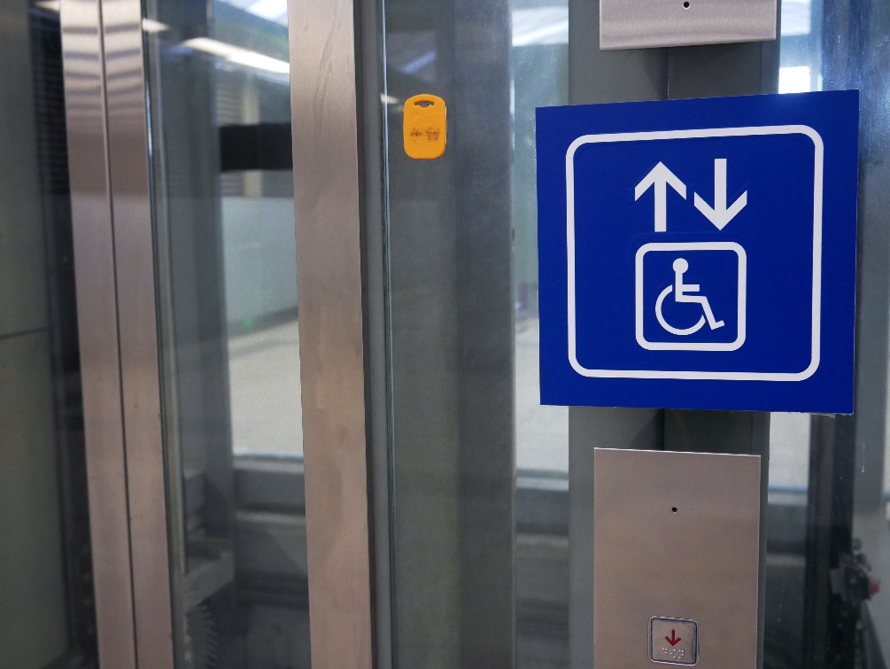
Deemed-to-Satisfy Provisions Part E3: Lift installations and Part F2: Sanitary and other facilities
E3.5 Landings
E3.6 Passenger lifts
E3.8 Residential care buildings
F2.1 Facilities in residential buildings
F2.2 Calculation of number of occupants and facilities
F2.3 Facilities in Class 3 to 9 buildings
F2.4 Accessible sanitary facilities
F2.9 Accessible adult change facilities
Specification F2.9 Accessible adult change facilities
Notes:
Part E3: Lift installations contains the following relevant access provisions:
E3.5 Landings;
E3.6 Passenger lifts; and
E3.8 Residential care buildings.
Part F2: Sanitary and other facilities contains:
F2.1 Facilities in residential buildings;
F2.2 Calculation of number of occupants and facilities;
F2.3 Facilities in Class 3 to 9 buildings;
F2.4 Accessible sanitary facilities; and
F2.9 Accessible adult change facilities.
Part F2 also contains Specification F2.9 relating to accessible adult change facilities

Slide 29
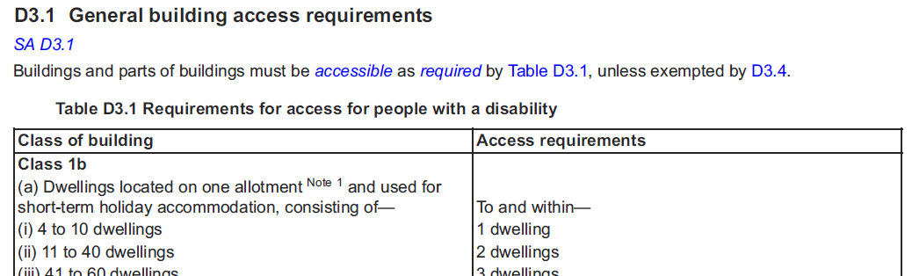
D3.1 – General access requirements
Table D3.1: sets out which buildings and parts of buildings have to be accessible.
The extent of access required depends on the class of building.
Different building classifications have different access requirements.
Notes:
We won’t go into detail on every one of these provisions, but we will touch on D3.1, E3.6, F2.4, F2.9 and H2.
D3.1 sets out which buildings and parts of buildings have to be accessible, and contains Table D3.1 which is the main roadmap for determining which buildings need to be accessible and to what extent.
Applying Table D3.1 is based on building classifications, and in some cases, specific uses within classifications. You should be aware that different classes of buildings may have different access requirements.
For example, an office building (Class 5) would generally require access to all areas normally used by the occupants, whereas hotels (Class 3) only require access to common areas of the building and some of the hotel rooms/units but not all.
Table D3.1 also has to be read alongside other parts of the NCC which describe some concessions and exemptions from the general rules in it. An example of this is D3.4 which provides some general exemptions for access to specified areas of buildings.

Slide 30
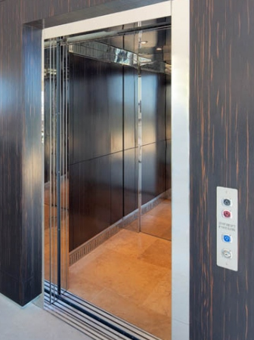
Deemed-to-Satisfy Provisions Part E3.6: Passenger lifts
Passenger lifts must be suitable for use by people with disability.
A variety of lift types can be used. However, Table E3.6a contains limitations on the use of some types of lifts.
Table E3.6b describes the features required on lifts such as handrails, lighting, control buttons and dimensions.
Notes:
The next part we'll look at is Part E3.6 – Passenger lifts. Part E3.6 identifies the range of lifts that can be used in buildings.
While the range is broad and allows for more cost effective approaches, especially for small buildings, there are some limits on when each type of lift can be used. Some types of lifts include:
an electric passenger lift;
a stairway platform lift which follows the flight of stairs on rails fixed at one side;
a low-rise platform lift; and
an inclined lift.
Table E3.6b provides general requirements for the main features of different lift types which include:
all lifts apart from stairway platform lifts and low-rise lifts must have a handrail;
all lifts that travel more than 12 m must have a minimum lift floor dimension of 1400 mm by 1600 mm;
all lifts, apart from stairway platform lifts must have lift landing doors at the upper landing; and
all lifts serving more than 2 levels must have automatic audible information within the lift car to identify the level each time the car stops.

Slide 31
Deemed-to-Satisfy Provisions Part F2.4: Accessible sanitary facilities
The general term ‘accessible sanitary facilities’ refers to:
accessible unisex sanitary compartments;
accessible unisex showers; and
toilets suitable for people with ambulant disabilities.
Part F2.4 sets out:
where accessible unisex sanitary compartments and unisex showers are required to be provided; and
requirements for ambulant accessible toilet cubicles.
Notes:
Next, we'll look at Part F2.4 – Accessible sanitary facilities.
The general term ‘accessible sanitary facilities’ refers to:
accessible unisex sanitary compartments (referred to generally as ‘accessible unisex toilets’, not ‘disabled toilets’);
accessible unisex showers; and
toilets suitable for people with ambulant disabilities.
Part F2.4 sets out:
where accessible unisex sanitary compartments and unisex showers are required to be provided; and
requirements for ambulant accessible toilet cubicles.

Slide 32
Deemed-to-Satisfy Provisions Part F2.4: Accessible sanitary facilities
Generally, accessible unisex sanitary compartments must be provided:
in buildings required to be accessible and containing toilets; and
on every accessible storey where there are toilets.
Circulation spaces and features of an accessible unisex toilet must comply with AS 1428.1.
Notes:
Generally, accessible unisex sanitary compartments must be provided:
in buildings required to be accessible and containing toilets; and
on every accessible storey where there are toilets.
It's important to note that circulation spaces and features of an accessible unisex toilet must comply with AS 1428.1: Design for access and mobility - General requirements for access - New building work.
While the NCC only requires a closet pan, washbasin, shelf or bench top and a sanitary towel disposal bin within a toilet, if other fixtures and fittings are included, such as a soap dispenser or mirror, they must also comply with the requirements of AS 1428.1.
Some individuals may require assistance using a toilet. Accessible toilets are therefore required to be unisex to allow for assistance by someone of any gender without entering an area reserved for a specific gender.

Slide 33
Deemed-to-Satisfy Provisions Part F2.4: Accessible sanitary facilities
Ambulant accessible toilets
A person with an ambulant disability is someone who is able to move about without the need for a wheeled mobility device, but who would benefit from the availability of a raised pan and handrails to assist in raising and lowering.
Design specifications for ‘ambulant accessible cubicles’ are also in AS 1428.1.
Notes:
We also need to consider ‘ambulant accessible toilets'. A person with an ambulant disability is someone who is able to move about without the need for a wheeled mobility device, but who would benefit from a raised pan and handrails to assist in raising and lowering.
The design specifications for ‘ambulant accessible toilets’ are in AS 1428.1 and include features such as door openings of minimum 700 mm, grab rails on both sides of the cubicle and a pan seat height of between 460 mm and 480 mm.
The requirements for ‘ambulant accessible toilets’ are only triggered if there are male/female toilets in addition to an accessible unisex toilet at a bank of toilets.
Design specifications for ‘ambulant accessible cubicles’ are also in AS 1428.1.

Slide 34
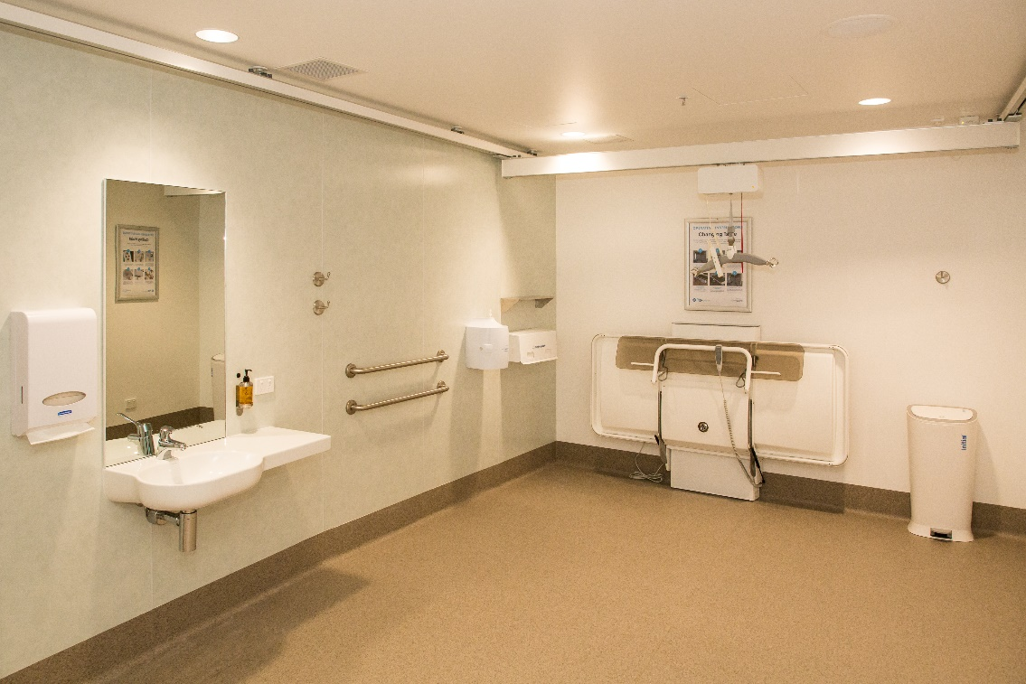
Deemed-to-Satisfy Provisions Part F2.9: Accessible adult change facilities
To be provided for some Class 6 shopping centres and some Class 9b buildings, depending on their purpose, floor space area and design occupancy.
Part F2.9 in conjunction with Specification F2.9, sets out the requirements and specifications.
The image to the bottom right is the external signage required for an accessible adult change facility.
Notes:
The NCC requires accessible adult change facilities to be provided in some Class 6 shopping centres and some Class 9b buildings, depending on their purpose, floor space area and design occupancy levels.
This requirement is primarily targeted at large public buildings including shopping centres, sports stadiums, aquatic centres, museums, art galleries and airports.
Part F2.9 in conjunction with Specification F2.9, sets out the particular requirements and specifications for accessible adult change facilities.
The image to the bottom right is the external signage required for an accessible adult change facility.

Slide 35
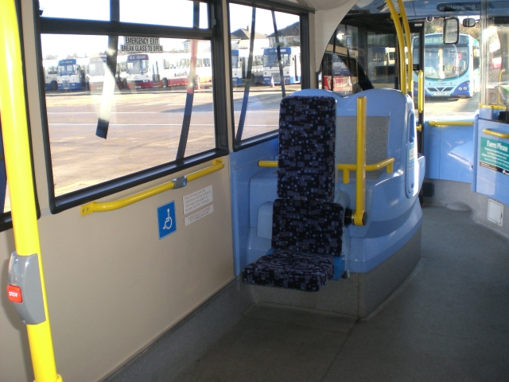
Deemed-to-Satisfy Provisions Part H2: Public transport buildings
Part H2 contains requirements for disability access in passenger use areas of public transport buildings, such as airports or railway stations.
Part H2 refers to different editions of Australian Standards for elements such as accessways, ramps, stairways, signage, lifts and doorways.
Notes:
The next part we'll look at is Part H2 – Public transport buildings. Part H2 contains requirements for disability access in passenger use areas of public transport buildings.
Specifically, Part H2 relates to buildings associated with public transport services, such as railway stations, bus interchanges and ferry terminals.
Since 2002, public transport related buildings have been subject to a set of national disability standards called the Disability Standards for Accessible Public Transport 2002. The design specifications in the Transport Standards are in some cases a little different to those generally applied in the NCC.
As a consequence of this, Part H2 refers to different editions of Australian Standards for elements such as accessways, ramps, stairways, signage, lifts and doorways.

Slide 36
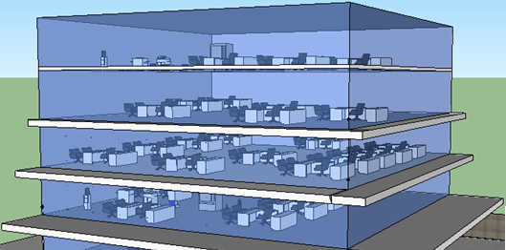
Alt text
Example: Applying NCC Volume One
Now let’s look at an example of applying the Deemed-to-Satisfy Provisions for this office building.
Classification
Alt text
General access requirements
Number of facilities required
Accessible sanitary facilities
Accessible features
Notes:
Now that we’ve covered what's in the relevant parts of Volume One, let’s consider an example of applying the Deemed-to-Satisfy Provisions.
The next few slides will follow on from what we have just learnt in the context of an office building and determining the number and types of sanitary facilities required.
Listed on the right hand side are some of the items we need to consider in applying the requirements.

Slide 37
Example: Applying NCC Volume One
What’s the building’s classification?
Classification
General access requirements
Number of facilities required
Accessible sanitary facilities
Accessible features
Answer:
Class 5
Notes:
Firstly, we'll need to determine the classification of the proposed building as per Part A6 in Volume One. So, what's the building classification?
Answer: An office building is a Class 5 building.

Slide 38
Example: Applying NCC Volume One
What extent of access is required?
Classification
General access requirements
Number of facilities required
Accessible sanitary facilities
Accessible features
Answer:
To and within all areas normally used by the occupants
Notes:
Secondly, we'll need to determine the extent of access for people with disability that must be provided to the building and within parts of the building as per D3.1 and Table D3.1.
Answer: For a Class 5 building, access is required to be provided to and within all areas of the building normally used by the occupants, with the exception of those areas exempted by D3.4.

Slide 39
Example: Applying NCC Volume One
If the office building accommodates 200 employees, evenly split between males and females, how many sanitary facilities would be required?
Classification
General access requirements
Number of facilities required
Accessible sanitary facilities
Accessible features
Answer:
For males: 5 pans; 3 urinals; 4 washbasins; and for females: 7 pans; 4 washbasins
Notes:
Thirdly, we'll need to determine the number of sanitary facilities required for our office building.
For the example, the building accommodates 200 employees, 50% male, and 50% female.
To work this out, we'll need to look at Part F2 of Volume One, specifically F2.3 and Table F2.3.
In accordance with Table F2.3, for a Class 5 office building, the answer would be:
For males: 5 pans; 3 urinals and 4 washbasins (to serve 100 males); and
For females: 7 pans and 4 washbasins (to serve 100 females).

Slide 40
Example: Applying NCC Volume One
Remember
accessible sanitary facilities!
Classification
General access requirements
Number of facilities required
Accessible sanitary facilities
Accessible features
Notes:
In a building required to be accessible, accessible unisex sanitary facilities must be provided in accessible parts of the building in accordance with F2.4.
For our office building, at least one accessible unisex sanitary compartment is required on each floor that contains sanitary compartments.
If a storey contains more than one bank of sanitary compartments containing male and female sanitary compartments, an accessible unisex sanitary compartment must be provided to not less than 50% of those banks.
Further to this, at each bank of toilets where there is one or more toilets in addition to an accessible unisex sanitary compartment, a sanitary compartment suitable for a person with an ambulant disability in accordance with AS 1428.1 must be provided for use by males and females.

Slide 41
Example: Applying NCC Volume One
How do I make the sanitary facilities accessible?
Classification
General access requirements
Number of facilities required
Accessible sanitary facilities
Accessible features
Answer: F2.4 refers to AS 1428.1 which contains the design and fit out requirements for accessible sanitary facilities
Notes:
So, how do I make the sanitary facilities accessible?
Answer: In relation to making the sanitary facilities accessible, F2.4 refers to AS 1428.1 which contains the design and fit out requirements for accessible sanitary facilities.
Finally, remember that the Deemed-to-Satisfy Provisions are only one option to achieve compliance with the Performance Requirements.

Slide 42
Other Matters
In this section we will look at:
existing buildings;
unjustifiable hardship;
the Guide to Volume One; and
the Guideline on the application of the Premises Standards.
Notes:
Now that we’ve had a brief overview of the requirements, there are some other things you should be aware of. In this section we will look at:
existing buildings;
unjustifiable hardship;
the Guide to Volume One; and
the Guideline on the application of the Premises Standards.

Slide 43
Existing Buildings
Under building law, any differentiation of requirements for existing buildings is a function of State and Territory building regulations rather than the NCC.
Three areas for particular consideration are:
exemptions for existing Class 1b and Class 2 buildings;
application of ‘affected part’; and
requirements for upgrades to existing lifts and accessible unisex toilets.
Notes:
It's important to remember that generally, the NCC applies equally to new buildings and new building work in existing buildings by virtue of State and Territory building regulations that apply the NCC.
However, the Premises Standards have different requirements for some existing buildings or features. Under building law, any differentiation of requirements for existing buildings is a function of State and Territory building regulations rather than the NCC. For this reason, a full understanding of what is required can only be achieved by looking at the NCC and relevant State and Territory building regulations.
Three areas for particular consideration are:
exemptions for existing Class 1b and Class 2 buildings;
application of what is referred to in the Premises Standards as the ‘affected part’ of a building; and
the requirements for upgrades to existing lifts and accessible unisex toilets.

Slide 44
Existing Buildings Class 1b and Class 2 buildings
Class 1b buildings:
Small hostels, guest and boarding houses, and B&Bs
Class 2 buildings:
Dwellings and apartments
Notes:
The Premises Standards contain a requirement that if an existing building is developed or upgraded into a B&B or farm stay type Class 1b building, the disability access requirements are not triggered unless there are 4 or more bedrooms made available to the public.
For an existing Class 2 building, the Premises Standards do not require a Class 2 building built before 1 May 2011 (or for which a building application was made before 1 May 2011) to meet the requirements for disability access if it is subsequently upgraded.
It is intended that State and Territory building regulations reflect the Premises Standards requirements for existing Class 1b and 2 buildings.

Slide 45
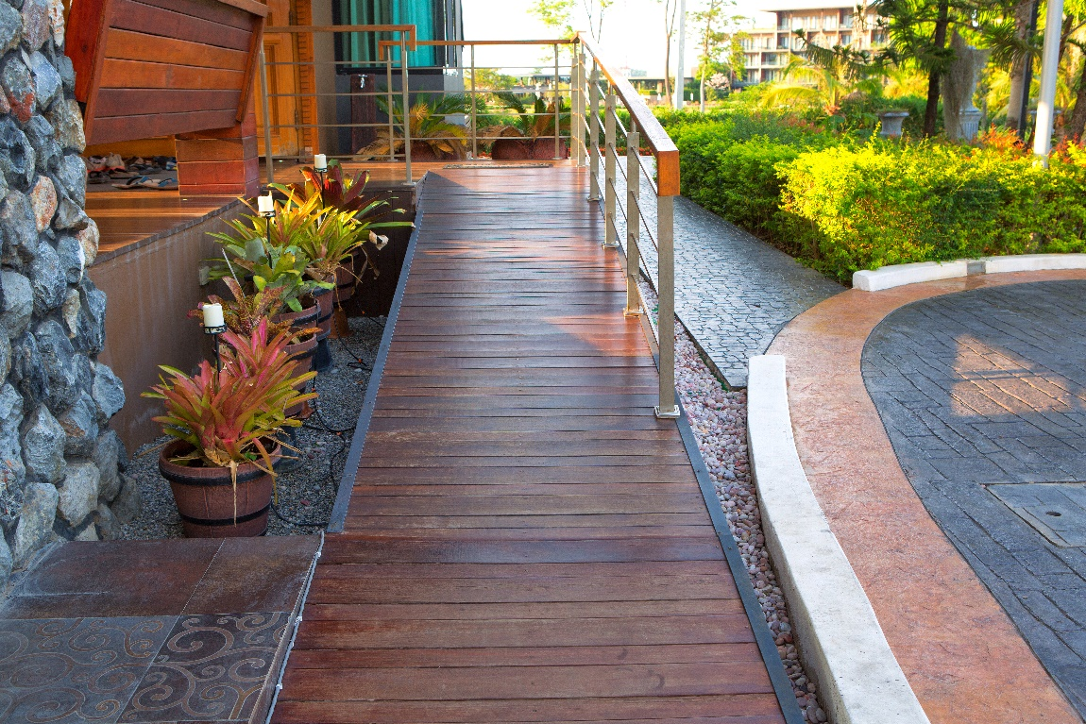
Existing Buildings: Affected Part
‘Affected part’ is the path of travel from the principle pedestrian entrance to any new work in an existing building.
Access upgrades are required if the building approval applicant is the owner, or the lessee if they occupy the whole building.
Notes:
The Premises Standards stipulates a requirement when upgrades to existing buildings are undertaken. This is a requirement that, in some situations, there will be a need to upgrade what is called the ‘affected part’ of a building.
This is the path of travel from the principle pedestrian entrance (main entrance) to the area of new work. In a multi-storey building, this could mean an upgrade of the path of travel from the main entrance to the lift and up the lift to the floor where the new work is taking place. Upgrading might involve removing a front entry step or upgrading required handrails.
The reason for this requirement is to encourage more extensive upgrades of buildings over time and to ensure that in appropriate cases, access is available to new areas of buildings that include accessibility – i.e. there is little point in having level 6 or 10 of a building fully accessible if you cannot get to that area.
There is a limit to the requirement for the upgrade of the ‘affected part.’
If the person making the application for building approval for the new work in an existing building is the owner or a tenant who occupies the whole building, this triggers the requirement for an upgrade of the affected part. However, if the person making the application is one of a number of lessees in the building, the requirement for affected part upgrade is not triggered.

Slide 46
Unjustifiable Hardship
The Premises Standards allows for a defence of unjustifiable hardship in some situations.
Compliance with the Premises Standards is still required to the maximum extent not involving unjustifiable hardship:
Example: enlarging a lift may impose unjustifiable hardship but upgrading the lift control panel to provide braille and tactile buttons may not.
Access panels or similar.
Notes:
The Premises Standards include a general exception for access provisions where the full application of requirements would result in what is called an ‘unjustifiable hardship’.
‘Unjustifiable hardship’ is not defined, but a list of factors provide guidance as to what is relevant in considering whether compliance with the Premises Standards might impose unjustifiable hardship. The factors include, but are not limited to, costs, loss of value, impact on revenue, capacity to pay and impact on financial viability and technical building factors. It demands an inquiry of what is fair and reasonable in the circumstances.
However, compliance with the Premises Standards is still required to the maximum extent not involving unjustifiable hardship. For example, enlarging a lift may impose unjustifiable hardship but upgrading the lift control panel to provide braille and tactile buttons may not.
There is no similar general exception in the NCC, but State and Territory governments have been encouraged to set up a mechanism for dealing with questions of unjustifiable hardship through State and Territory administrative processes. In some States and Territories, Access Panels or similar bodies have been established to deal with these questions.

Slide 47
Guide to Volume One and Guideline on the application of the Premises Standards
To accompany NCC Volume One, the ABCB produces the Guide to Volume One, which:
provides background and explanatory information; and
provides valuable assistance in understanding the relationships between Parts of the BCA and is a valuable aid when interpreting provisions.
To assist in the understanding and application of the Premises Standards the Australian Human Rights Commission has produced a publication titled, ”Guideline on the application of the Premises Standards”.
ncc.abcb.gov.au
humanrights.gov.au
Notes:
To accompany NCC Volume One, the ABCB produces the Guide to Volume One, which:
provides background and explanatory information including the Objectives and Functional Statements; and
provides valuable assistance in understanding the relationships between Parts of the BCA and is a valuable aid when interpreting provisions.
It can be accessed within NCC Volume One online at ncc.abcb.gov.au.
To assist in the understanding and application of the Premises Standards the Australian Human Rights Commission has produced a very useful accompanying document titled, “Guideline on the Application of the Premises Standards”.
This Guideline was prepared to assist those responsible for buildings and those interested in access to buildings and provides an outline of the standards, highlighting the main principles, and indicates who has rights and responsibilities under this. It also provides a commentary providing further clarification on different elements of the standards.
It can be accessed from the Human Rights Commission website at humanrights.gov.au.

Slide 48
Conclusion
Upon completion, you’ll have gained a basic understanding of the NCC disability access requirements with a focus on:
the application of the NCC; and
background and objective of the NCC disability access requirements within NCC Volume One.
You will have also gained a basic understanding of:
defined terms;
referenced documents;
Performance Requirements;
Verification Methods and
Deemed-to-Satisfy Provisions.
Notes:
Upon completion, you’ll have gained a basic understanding of the NCC Disability Access requirements with a focus on:
application of the NCC
background and objective of the NCC access provisions
an overview of the NCC access provisions including relevant:
defined terms;
referenced documents
Performance Requirements;
Verification Methods and
Deemed-to-Satisfy Provisions.

Slide 49
Assessment Questions
Answers are indicated in red.
Question 1
Class 2-9 buildings are generally:
Industrial buildings
Commercial buildings
Institutional buildings
All of the above.
Question 2
True or false? The NCC Performance Requirements set out means of achieving compliance with the Deemed-to-Satisfy Provisions.
True
False.

Slide 50
Assessment Questions (continued)
Question 3
True or false? By complying with the Deemed-to-Satisfy Provisions of the NCC it will ensure compliance with the Access Code of the Premises Standards.
True
False.
Question 4
The purpose of the Guide to Volume One is to:
Provide background and explanatory information
Provide assistance in understanding relationships between different parts of Volume One
Provide assistance when interpreting provisions
All of the above.

Slide 51
Assessment Questions (continued)
Question 5
True or false? The NCC access provisions reflect the requirements of the Premises Standards made under the Disability Discrimination Act 1992.
True
False.
Question 6
True or false? The role of the NCC is to provide nationally consistent minimum necessary regulations.
True
False.

Slide 52
Assessment Questions (continued)
Question 7
The requirements regarding access for people with a disability for certain Class 1b buildings are contained in:
Volume One
Volume Two
Volume Three
None of the above.
Question 8
True or false? NCC referenced documents are listed in Schedule 4 of the NCC, these documents are adopted as a deemed-to-satisfy means of complying with the Performance Requirements.
True
False.

Slide 53
Assessment Questions (continued)
Question 9
True or false? Disability access requirements have been in the BCA since 1998.
True
False.
Question 10
Do the NCC access provisions address building management policies?
Yes
No.

Slide 54
Assessment Questions (continued)
Question 11
The definition of “accessible” in the NCC is:
Accessible …
means a continuous accessible path of travel to, into or within a building
means having features such as a path of travel to enable use by people with a disability into or within a building
means having features to enable use by people with a disability
means general access requirements to new buildings.
Question 12
For a Class 5 office building, access would be required:
Only to certain areas within buildings
To and within all areas normally used by the occupants
To only a certain number of the offices within the building.

Slide 55
Copyright, Attribution & Disclaimer
Copyright
© Commonwealth of Australia and the States and Territories of Australia 2020, published by the Australian Building Codes Board.
The material in this publication is licensed under a Creative Commons Attribution—4.0 International licence, with the exception of: any third party material, any trademarks, and any images or photographs. More information on this CC BY licence is set out at the Creative Commons Website. Enquiries about this publication can be sent to: Australian Building Codes Board ,GPO Box 2013, CANBERRA ACT 2601. Phone: 1300 134 631, Email: ncc@abcb.gov.au www.abcb.gov.au.
Attribution
Use of all or part of this publication must include the following attribution:
© Commonwealth of Australia and the States and Territories 2020, published by the Australian Building Codes Board.
Disclaimer
By accessing or using this publication, you agree to the following:
While care has been taken in the preparation of this publication, it may not be complete or up-to-date. You can ensure that you are using a complete and up-to-date version by checking the Australian Building Codes Board website (www.abcb.gov.au).
The Australian Building Codes Board, the Commonwealth of Australia and States and Territories of Australia do not accept any liability, including liability for negligence, for any loss (howsoever caused), damage, injury, expense or cost incurred by any person as a result of accessing, using or relying upon this publication, to the maximum extent permitted by law. No representation or warranty is made or given as to the currency, accuracy, reliability, merchantability, fitness for any purpose or completeness of this publication or any information which may appear on any linked websites, or in other linked information sources, and all such representations and warranties are excluded to the extent permitted by law.
This publication is not legal or professional advice. Persons rely upon this publication entirely at their own risk and must take responsibility for assessing the relevance and accuracy of the information in relation to their particular circumstances.

