Slide 1
NCC Volume One: Energy Efficiency
Insert Corporate logo here
© Commonwealth of Australia and the States and Territories of Australia 2020, published by the Australian Building Codes Board.
Notes:
NCC Essentials – NCC Volume One Energy Efficiency
The following notice does not form part of the NCC Essentials script.
Copyright
© Commonwealth of Australia and the States and Territories of Australia 2020, published by the Australian Building Codes Board.
The material in this publication is licensed under a Creative Commons Attribution—4.0 International licence, with the exception of: any third party material, any trademarks, and any images or photographs. More information on this CC BY licence is set out at the Creative Commons Website. Enquiries about this publication can be sent to:
Australian Building Codes Board ,GPO Box 2013, CANBERRA ACT 2601
Phone: 1300 134 631
Email: ncc@abcb.gov.au www.abcb.gov.au
Attribution
Use of all or part of this publication must include the following attribution:
© Commonwealth of Australia and the States and Territories 2020, published by the Australian Building Codes Board.
Disclaimer
By accessing or using this publication, you agree to the following:
While care has been taken in the preparation of this publication, it may not be complete or up-to-date. You can ensure that you are using a complete and up-to-date version by checking the Australian Building Codes Board website (www.abcb.gov.au).
The Australian Building Codes Board, the Commonwealth of Australia and States and Territories of Australia do not accept any liability, including liability for negligence, for any loss (howsoever caused), damage, injury, expense or cost incurred by any person as a result of accessing, using or relying upon this publication, to the maximum extent permitted by law. No representation or warranty is made or given as to the currency, accuracy, reliability, merchantability, fitness for any purpose or completeness of this publication or any information which may appear on any linked websites, or in other linked information sources, and all such representations and warranties are excluded to the extent permitted by law.
This publication is not legal or professional advice. Persons rely upon this publication entirely at their own risk and must take responsibility for assessing the relevance and accuracy of the information in relation to their particular circumstances.

Slide 2
Table of contents
Introduction
How it works
What you’ll learn.
Contents
Background & objectives of the NCC energy efficiency
requirements.
An overview of NCC Volume One energy efficiency requirements
Summary
Notes:
The introduction will cover how it works and what you’ll learn.
The contents include the background & objectives of the NCC energy efficiency requirements and an overview of specific energy efficiency requirements in Volume One.
There’s also an overview of the different ABCB Calculators available to assist with the application of the energy efficiency provisions and a summary.

Slide 3
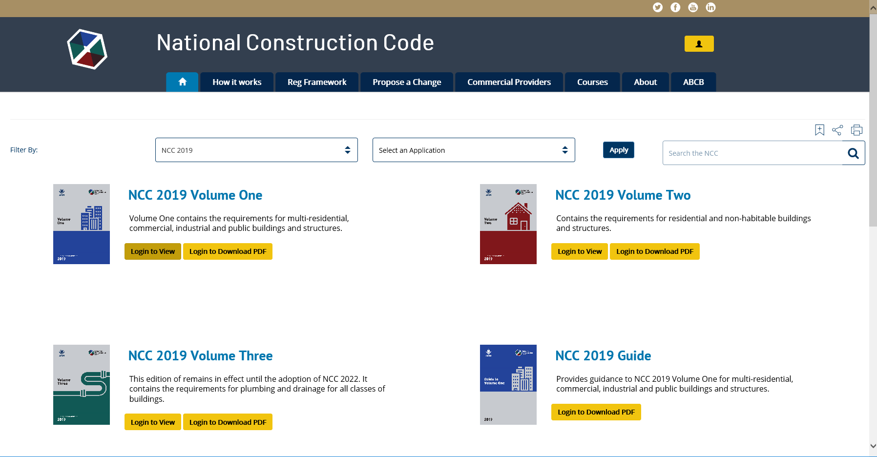
How to access the NCC
To access the NCC, visit: ncc.abcb.gov.au
To access the NCC, register your details here and submit a password here to receive your confirmation email.
Notes:
The NCC is freely available online via the ABCB website.
First time users should select the “Register” option (top right of the ABCB home page).
Once registered, users are sent a confirmation email that allows access to the NCC online and in downloadable PDF format.

Slide 4
What you will learn
Aims and objectives
To provide you with a basic understanding of the energy efficiency requirements in NCC Volume One.
Who this material is for
All building and plumbing professionals.
Notes:
The aim is to provide you with a basic understanding of the NCC Volume One energy efficiency provisions.
This material is designed for all building and plumbing professionals, but especially for those with an interest in energy efficiency and sustainability.

Slide 5
Overview of the NCC
The role of the NCC is to provide:
nationally consistent, minimum necessary regulations; and
a technical base for the design and construction of buildings and certain structures.
There are three performance-based volumes in the NCC:
the Building Code of Australia (BCA) (Volumes One and Two); and
the Plumbing Code of Australia (PCA) (Volume Three).
Notes:
Let’s look at a brief overview of the NCC.
The NCC is an initiative of the Council of Australian Governments (COAG) to incorporate all on-site construction requirements into a single code. Its role is to provide nationally consistent minimum necessary regulations and a technical base for the design and construction of buildings and certain structures throughout Australia.
There are three volumes in the NCC and all three are performance-based.
The Building Code of Australia or the ‘BCA’, makes up Volume One and Volume Two of the NCC. Volume One primarily covers Class 2 to Class 9 buildings and Volume Two, Class 1 and Class 10 buildings.
Volume Three of the NCC is the Plumbing Code of Australia or ‘PCA’. This pertains primarily to plumbing and drainage associated with all building classifications.
Generally, the NCC applies to the construction of new buildings and new building and plumbing work in existing buildings. The NCC also applies to the change of use of a building.
The NCC takes effect as a regulatory document through its adoption by state and territory legislation.

Slide 6
NCC Volume One: Overview
Volume One contains the design and construction requirements for Class 2 to 9 buildings.
It also contains certain requirements for Class 1b, 10a and 10b buildings and structures.
Class 2 to 9 buildings are generally commercial, industrial, multi-residential, and institutional buildings.
Volume One contains 9 distinct Sections (A to J).
Notes:
Let’s look at Volume One in greater detail.
Volume One of the NCC contains the design and construction requirements for Class 2 to 9 buildings as well as certain requirements for Class 1b, 10a and 10b buildings. These requirements cover such matters as structure, fire resistance, access and egress, services and equipment, and energy efficiency as well as certain aspects of health and amenity.
Class 2 to 9 buildings are generally commercial, industrial, multi-residential, and institutional buildings.
Volume One has nine specific Sections, however, before we get into each of these Sections we will take a closer look at the structure and compliance with Volume One.

Slide 7
NCC Volume One: Overview
NCC Volume One is a performance-based code.
Compliance with the NCC is achieved by satisfying the Governing Requirements and the Performance Requirements.
Notes:
As with NCC Volumes Two and Three, NCC Volume One is a performance-based code.
Compliance with the NCC is achieved by satisfying the Performance Requirements and the supporting Governing Requirements.
The top level, the Performance Requirement is the Compliance Level. The bottom level are the Compliance Solutions, which are Performance Solutions or Deemed-to-Satisfy Solutions.
The NCC Compliance Structure shown is located in the Governing Requirements of the NCC in Part A2.

Slide 8
Energy efficiency: Relevant Sections
The relevant Sections in NCC Volume One for energy efficiency requirements are:
Section A: This contains reference to specific defined terms, referenced documents and building classifications.
Section J: This contains the energy efficiency requirements for buildings, structures and services.
Notes:
The relevant Sections in Volume One relevant to energy efficiency are:
Section A, the Governing Requirements: which contains reference to specific defined terms, referenced documents and building classifications.
Section J: which contains the energy efficiency requirements for buildings, structures and services.

Slide 9
Energy efficiency
Human induced climate change arising from greenhouse gas (GHG) emissions are a concern.
GHG emissions predominantly come from the burning of fossil fuels (coal, oil, gas).
Australia’s building and construction industry is having an increasing impact on society and on our environment.
Increases in population place further pressure on resources and infrastructure such as water, electricity and land.
Notes:
In recent years, awareness has increased about greenhouse gas (or GHG) emissions and the affect greenhouse gas emissions have on global warming.
It’s important to note that greenhouse gases are a natural part of the Earth’s atmosphere to capture the sun’s warmth, but the most pressing issue is human induced climate change resulting from increasing greenhouse gas emissions.
While the building sector is not the largest contributor to greenhouse gas emissions, it is one of the fastest growing sources. Energy used in buildings accounts for around 20% of all energy related greenhouse gas emissions in Australia.
Increasing population adds further pressure to resources and infrastructure.

Slide 10
Energy efficiency and the NCC
Energy efficiency provisions have been in Volume One since 2005 for multi-residential buildings.
Provisions for all other non-residential buildings were introduced in 2006.
Minimum requirements have increased overtime with major changes introduced in 2010 and 2019.
Notes:
Since 2005, the Volume One has contained energy efficiency measures for multi-residential buildings.
In 2006, additional measures were introduced for all other non-residential building classifications with the objective of reducing greenhouse gas emissions by efficiently using energy and by using renewable energy for building services from low greenhouse intensity sources.
The minimum levels of energy efficiency have increased over time, with major changes introduced in 2010 and 2019.

Slide 11
Achieving energy efficiency
A more energy efficient building should consider:
the climate related to its location;
appropriate shading, glazing and insulation;
thermal mass;
adequate building sealing (to minimise air leakage);
optimal orientation;
adequate ventilation (to allow for cooling); and
improving the efficiency of heating, cooling, lighting, heated water systems and swimming pool and spa equipment.
Notes:
To achieve a more energy efficient building,
the climate related to its location;
appropriate shading, glazing and insulation;
thermal mass;
adequate building sealing (to minimise air leakage);
optimal orientation;
adequate ventilation (to allow for cooling); and
improving the efficiency of heating, cooling, lighting, heated water systems and swimming pool and spa equipment, should be considered.

Slide 12
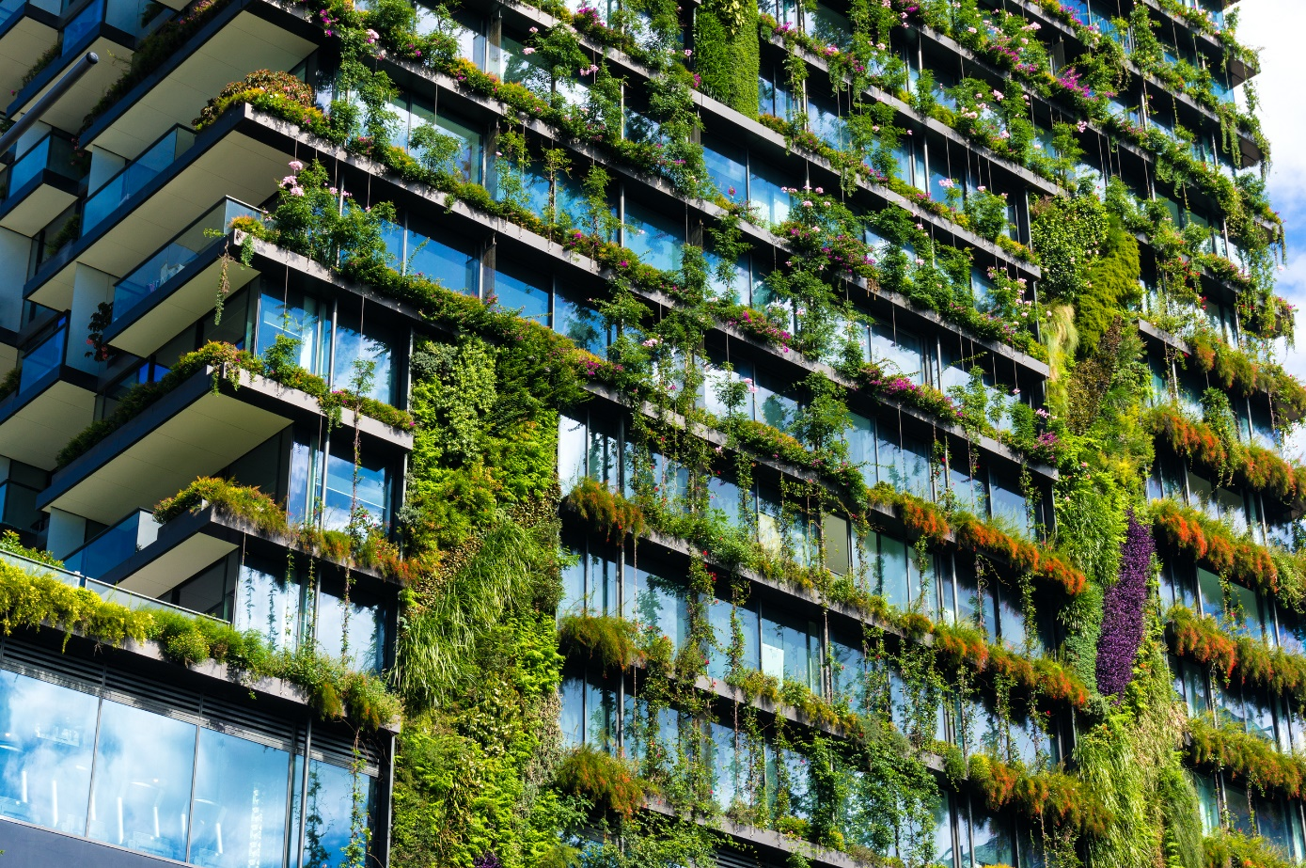
Energy efficiency in Volume One
NCC energy efficiency requirements primarily address:
thermal performance of building fabric; and
services - including heating and cooling, lighting and heated water.
Notes:
In the NCC, the energy efficiency requirements address:
The thermal performance of the building - i.e. heat flow - in and out of the building envelope; and
services - including energy use of air-conditioning, heated water and lighting and the source of heating energy.
This is done by facilitating the efficient use of energy, including for services such as heating, cooling and lighting.

Slide 13
NCC energy efficiency requirements
In this section we will look at the NCC energy efficiency requirements in more detail including relevant:
Definitions;
Performance Requirements;
Verification Method; and
Deemed-to-Satisfy Provisions.
Notes:
In this section we will look at the NCC energy efficiency provisions in more detail including relevant:
Definitions;
Performance Requirements;
The Verification Method; and
Deemed-to-Satisfy Provisions.

Slide 14
Energy efficiency: Definitions
Definitions are specific to the NCC – it’s important not to assume the meaning of a definition.
Definitions are located in Schedule 3 of each Volume of the NCC.
Defined terms are italicised in the NCC.
Some relevant to energy efficiency include:
Climate zone
Conditioned space
Envelope.
Notes:
Interpreting and applying the NCC relies on using defined terms. Definitions are italicised in the NCC and are located in Schedule 3 of each Volume. They are specific to the NCC, so it's important not to assume the meaning of a definition.
Some definitions relevant to energy efficiency in Volume One include:
Climate zone;
Conditioned space; and
Envelope.

Slide 15
Energy efficiency: Definitions Example: Conditioned space
Notes:
Let’s look at these terms in more detail, starting with conditioned space.
A conditioned space is a space within a building where the environment will have its temperature controlled by air-conditioning, that is it’s actively heated or cooled.
An understanding of this term is needed as it forms the basis for how the NCC energy efficiency provisions are applied. It is also referenced another definition, air-conditioning.

Slide 16
Energy Efficiency: Definitions Example: Envelope
Notes:
The envelope of a building is specifically defined for use in the NCC energy efficiency provisions to assist in identifying the boundary between a conditioned and non-conditioned space.
For the purposes of Section J, envelope is defined as:
“… the parts of a building’s fabric that separate a conditioned space or habitable room from:
the exterior of the building; or
a non-conditioned space including:
the floor of a rooftop plant room, lift- machine room or the like; and
the floor above a carpark or warehouse; and
the common wall with a carpark, warehouse or the like.”
The easiest way to consider this definition is to identify the areas of the building that are conditioned, which can be conditioned or constitute a habitable room which is likely to be conditioned if uncomfortable. The walls, roofs, ceilings and floors that bound these spaces are considered to be the envelope if there is a non-conditioned space on the other side.
This image shows an example of how to define the envelope, using the green dashed line.

Slide 17
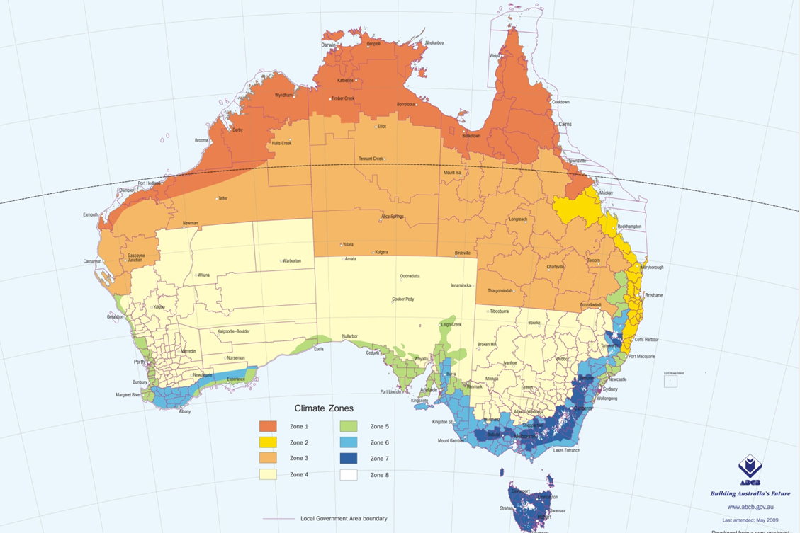
Definitions: Climate zones
Climate zones for thermal design
NCC Volume One
Schedule 3
Figure 2
abcb.gov.au
Notes:
This map is reproduced from the definition for climate zone in the NCC. It's found in Schedule 3, where it appears as Figure 2. This map, and its associated table, Table 2 defines the eight NCC climate zones for energy efficiency and are important in applying the provisions.
The different climates are shown by the various colours with climate zone 1 being the dark orange parts in northern Australia and climate zone 8 being the small white parts in south east regions.
The NCC climate zones are described at:
Climate zone 1 - High humidity summer, warm winter
Climate zone 2 - Warm humid summer, mild winter
Climate zone 3 - Hot dry summer, warm winter
Climate zone 4 - Hot dry summer, cool winter
Climate zone 5 - Warm temperate
Climate zone 6 - Mild temperate
Climate zone 7 - Cool temperate
Climate zone 8 - Alpine
A larger expandable version is also available from the ABCB website, as are specific State and Territory maps. Visit: abcb.gov.au.

Slide 18
Section J: Performance Requirement
The Performance Requirement for energy efficiency is JP1 Energy use.
It requires that a building, including its services, use energy efficiently so that the greenhouse gas emissions associated with its operation are minimised.
This is subject to the intended use of the building and the necessary level of occupant comfort.
For conditioned buildings, the amount of acceptable energy usage has also been quantified.
Notes:
Section J in NCC Volume One contains the energy efficiency requirements for buildings, structures and services.
In broad terms, the NCC Performance Requirement for energy efficiency seeks to reduce greenhouse gas emissions.
There is one Performance Requirement for energy efficiency, which cover both the building and its services. They are concerned with the efficient use of energy relevant to its function and use and level of human comfort.
The annual hours of energy consumption for a conditioned space is quantified based on the type of building.
Remember, within the NCC, the Performance Requirements are the only mandatory part of the code and set the levels of performance that must be met.

Slide 19
Example: JP1 Energy use
Notes:
Let’s take a look at the quantified part of the relevant Performance Requirement.
Performance Requirement JP1 addresses the hourly regulated energy consumption for conditioning a building over the annual hours of operation.
As an example, for a Class 6 building (such as a shop), this must not exceed 80 kJ per meter square per hour.

Slide 20
Section J: Verification Methods
Section J contains four Verification Methods that can be used to demonstrate compliance with all or part of the Performance Requirement JP1.
JV1 NABERS Energy for Offices;
JV2 Green Star;
JV3 Verification using a reference building; and
JV4 Building envelope sealing.
Notes:
Section J also contains four Verification Methods that may be used to demonstrate compliance with the Performance Requirement JP1.
The four Verification Methods are:
JV1 NABERS Energy for Offices;
JV2 Green Star;
JV3 Verification using a reference building; and
JV4 Building envelope sealing.
JV1, JV2 and JV3 all rely on using calculation methods that comply with ANS/ASHRAE Standard 140, commonly used in building energy simulation tools.

Slide 21
Section J: Verification Methods
JV1 NABERS Energy for Offices
NABERS Energy is an energy modelling framework that benchmarks a building's energy use against a 6-star scale.
Can only be used for Class 5 buildings (i.e. offices).
A NABERS based energy model and a NABERS Energy for Offices base building Commitment Agreement at a 5.5 star level or above is needed.
Additional thermal comfort targets and other Deemed-to-Satisfy Provisions also apply.
Notes:
Let’s look at Verification Methods in more detail.
JV1 NABERS Energy for Offices
Class 5 buildings (i.e. offices) can use JV1.
NABERS Energy is an energy modelling framework, used primarily to benchmark a building's energy use against a 6-star scale. It is most commonly used to the benchmark the actual performance of a building, but its protocols can also be used to predict how much energy a building would use.
The requirement in the NCC is for the building to obtain an energy model showing that it’s base building component will produce greenhouse gas emissions will be at least 67% of 5.5 star on the NABERS Energy for Office base building scale and that a Commitment Agreement.
Additional thermal comfort and other Deemed-to-Satisfy Provisions also apply.

Slide 22
Section J: Verification Methods
JV2 Green Star
Green Star is a rating tool.
It compares the proposed building to a reference building compliant with the Deemed-to-Satisfy Provisions in Section J.
Can be used for Class 3, 5, 6, 7, 8 or 9 buildings and common areas of Class 2 buildings.
The Green Star – Design and As-Built rating needs to comply with the simulation requirements and be registered.
Additional thermal comfort targets and other Deemed-to-Satisfy Provisions also apply.
Notes:
JV2 Green Star
Green Star is a rating tool that compares the proposed building to a reference building compliant with the Deemed-to-Satisfy Provisions in Section J. In this way it is similar to operation to JV3.
A building that achieves a Green Star Design and As-Built rating, will exceed the minimum energy efficiency requirements of JP1.
JV2 can be used for Class 3, 5, 6, 7, 8 or 9 buildings and common areas of Class 2 buildings, with additional thermal comfort targets and other Deemed-to-Satisfy Provisions applying to satisfy NCC energy efficiency requirements.

Slide 23
Section J: Verification Methods
JV3 Verification using a reference building
Compares annual greenhouse gas emissions of a proposed building to that of a reference building.
The reference building is based on satisfying the Deemed-to-Satisfy Provisions.
If the greenhouse gas emissions of the proposed building do not exceed that of the reference building, JP1 is satisfied.
Can be used for Class 3, 5, 6, 7, 8 or 9 buildings and common areas of Class 2 buildings
Additional thermal comfort targets and other Deemed-to-Satisfy Provisions also apply.
Notes:
The last of the three whole of building Verification Methods is JV3. JV3 is verification using a reference building.
This Verification Method compares the annual greenhouse gas emissions of a proposed building to that of a reference building which is based on the Deemed-to-Satisfy Provisions.
If the greenhouse gas emissions of the proposed building do not exceed that of the reference building, JP1 is satisfied.
It can be used for Class 3, 5, 6, 7, 8 or 9 buildings and common areas of Class 2 buildings.
Additional thermal comfort targets and other Deemed-to-Satisfy Provisions also apply.

Slide 24
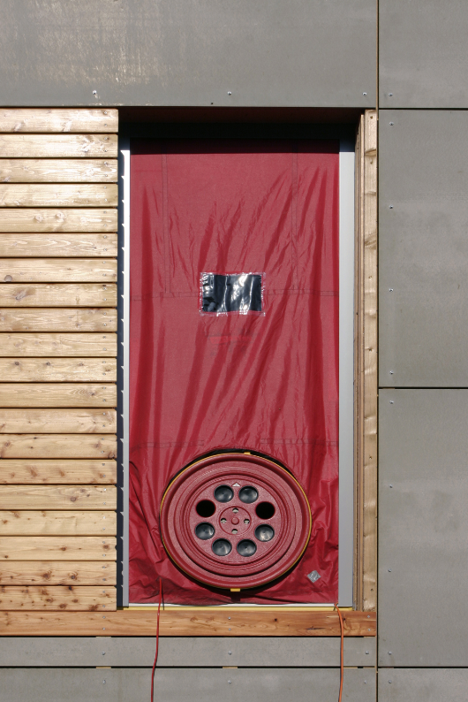
Section J: Verification Methods
JV4 Building envelope sealing
Building sealing is essential for facilitating the energy efficiency of a building.
JV4 provides a method of satisfying the building sealing requirements in JP1(e).
Can be used for Class 2, 3, 4, 5, 6, 8 and 9 buildings.
This provides an option to the prescriptive building sealing requirements in Part J3.
Notes:
Lastly, let’s look at the Verification Method JV4, Building envelope sealing.
Building sealing is essential for facilitating the energy efficiency of a building.
JV4 provides a method of demonstrating compliance with the building sealing requirements in JP1(e).
It can be used for Class 2, 3, 4, 5, 6, 8 or 9 buildings.
JV4 provides an option to the prescriptive building sealing requirements in Part J3.

Slide 25
Section J: Deemed-to-Satisfy Provisions
A Deemed-to-Satisfy Solution, which complies with the Deemed-to-Satisfy Provisions is deemed to comply with the Performance Requirements.
Compliance with the Deemed-to-Satisfy Provisions is one way to ensure compliance with the Performance Requirements.
Notes:
If a practitioner chooses a Deemed-to-Satisfy Solution that complies with the Deemed-to-Satisfy Provisions, it is deemed to meet the corresponding Performance Requirements.
The Deemed-to-Satisfy Provisions in Parts J0 to J8 describe one way of meeting the Performance Requirements.

Slide 26
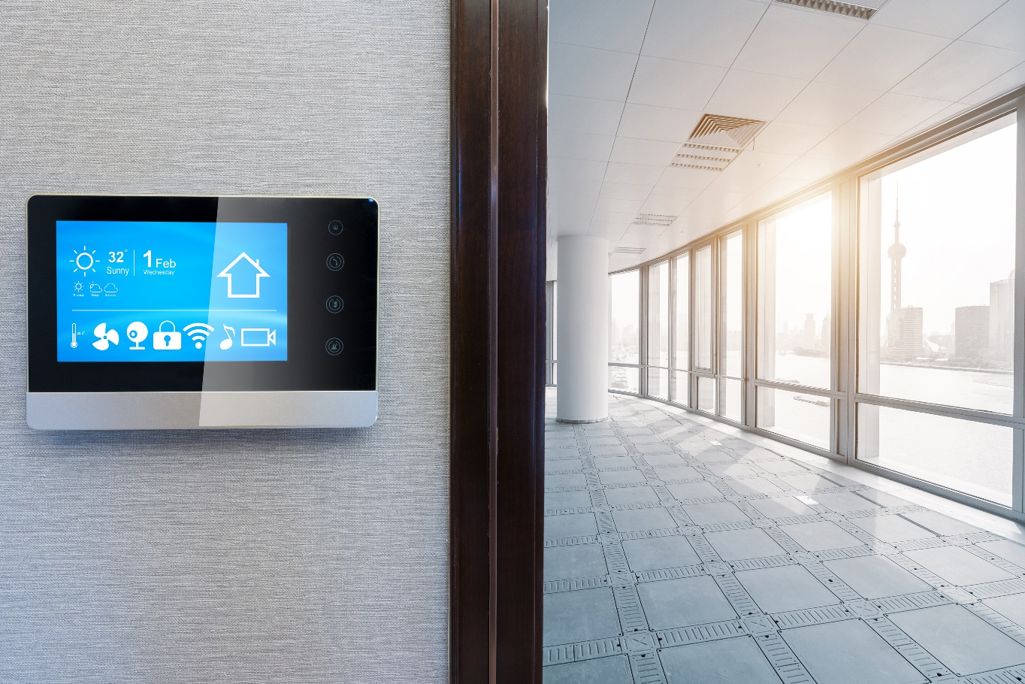
Section J: Deemed-to-Satisfy Provisions
Section J has seven Parts, which are:
Part J0: Energy efficiency;
Part J1: Building fabric;
Part J3: Building sealing;
Part J5: Air-conditioning and ventilation systems;
Part J6: Artificial lighting and power;
Part J7: Heated water supply and swimming pool and spa plant; and
Part J8: Facilities for monitoring.
Notes:
The Deemed-to-Satisfy Provisions in Section J are contained in seven Parts, which are:
Part J0: Energy efficiency;
Part J1: Building fabric;
Part J3: Building sealing;
Part J5: Air-conditioning and ventilation systems;
Part J6: Artificial lighting and power;
Part J7: Heated water supply and swimming pool and spa plant; and
Part J8: Facilities for monitoring.
It should be noted that the content of Parts J2 and J4 which existed in previous editions of Volume One, have been removed. The Part number has been retained so as not to change the numbering of the other Parts from previous editions.

Slide 27
Section J: Energy efficiency specifications
Building fabric
Specification J1.2: Material properties
Specification J1.5a: Calculation of U-Value and solar admittance
Specification J1.5b: Spandrel panel thermal performance
Specification J1.6: Sub-floor thermal performance.
Services
Specification J6: Lighting and power control devices.
Notes:
There are also five specifications relevant to the Section J Deemed-to-Satisfy Provisions. The Specifications support the Deemed-to-Satisfy Provisions.

Slide 28
Part J0 – Deemed-to-Satisfy Provisions
Part J0 outlines the Deemed-to-Satisfy Provisions in Parts J1 to J8 when developing a Deemed-to-Satisfy Solution to satisfy the Performance Requirement JP1.
Part J0 provides a reminder that a Performance Solution may be proposed instead of the Deemed-to-Satisfy Provisions.
Part J0 also contains a number of DTS provisions relevant to the Single Occupancy Units (SOUs) of Class 2 and Class 4 buildings.
Notes:
Part J0 outlines the Deemed-to-Satisfy Provisions in Parts J1 to J8 when developing a Deemed-to-Satisfy Solution to satisfy the Performance Requirement JP1.
Part J0 provides a reminder that a Performance Solution may be proposed instead of the Deemed-to-Satisfy Provisions.
Part J0 also contains a number of DTS provisions relevant to the Single Occupancy Units (SOUs) of Class 2 and Class 4 buildings.

Slide 29
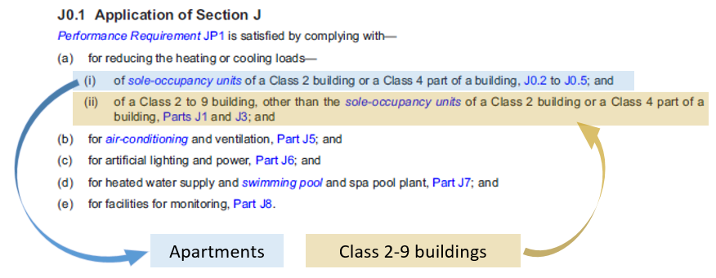
Part J0.1 Application of Section J
Notes:
The application of the Deemed-to-Satisfy Provisions for Section J is provided in Part J0.1. This is where the requirements are prescribed based on the class of building.
Almost all of the Deemed-to-Satisfy Provisions of Section J apply to all NCC Volume One building classifications. However, there is a distinct difference in how reducing heating and/or cooling loads are treated for sole-occupancy units, or SOUs of Class 2 buildings and Class 4 parts of a building compared to other areas of these buildings and Class 3 and 5 to 9 buildings.
To assist in explaining the Deemed-to-Satisfy Provisions, we will refer to the Application in J0.1(a)(i) as the requirements for apartments and the application of J0.1(a)(ii) as Class 2-9 buildings.

Slide 30
Deemed-to-Satisfy Provisions: Apartments
Energy rating solution for apartments
J0.2 requires:
a minimum 5 star energy rating (for an individual apartment);
a collective average energy rating of 6 stars;
minimum and separate heating and cooling load limits
Using NatHERS accredited house energy rating software.
Notes:
For Class 2 buildings or Class 4 parts of a building (i.e. apartments), J0.2 requires:
a minimum 5 star energy rating for an individual apartment;
a collective average energy rating of 6 stars;
minimum and separate heating and cooling load limits; and
Using NatHERS accredited house energy rating software.
The energy rating is based on the combined heating and cooling load of the dwelling, whereas the heating and cooling load limits are based on the separate heating and cooling loads of the apartment.
Nationwide House Energy Rating Scheme (or NatHERS) accredited energy rating software, outputs the energy rating and the heating and cooling loads relevant to the building design and its location.
An energy rating is:
a quantified benchmark used to describe energy efficiency performance (in stars);
based on an annual energy load and climate;
derived from using NatHERS accredited computer software tools; and
based on a numeric scale of energy load from ZERO (no energy efficiency features or savings) to TEN (a building that does not need additional energy to heat or cool).
The numbers behind the ratings vary between climate zones.
The heating and cooling load limits are published in the ABCB Standard for NatHERS Heating and Cooling Load Limits, which can be accessed at abcb.gov.au.
A Class 2 or Class 4 part of a building must comply with both elements – achieve both the minimum star rating, and the required separate heating and cooling load limits.

Slide 31
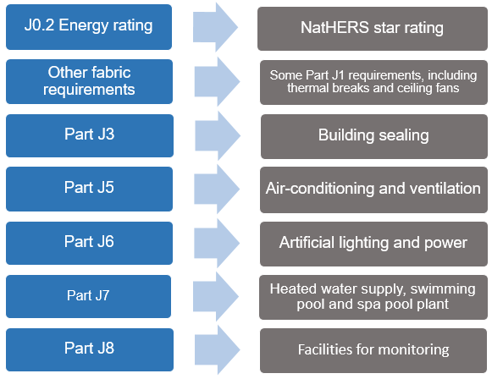
Deemed-to-Satisfy Provisions: Apartments
Part J0 – Apartments
For sole-occupancy units in Class 2 buildings and Class 4 parts of buildings.
Notes:
For apartments, the energy rating alone does not fully satisfy the Deemed-to-Satisfy Provisions. In addition to the energy rating, various other Parts of Section J need to be met to achieve compliance with the Deemed-to-Satisfy Provisions for energy efficiency, which include:
ceiling fan requirements in J0.3;
roof thermal breaks in J0.4;
wall thermal breaks in J0.5;
specific building fabric requirements in Part J1 Building Fabric;
building sealing requirements in Part J3 Building Sealing; and
other building services requirements in Parts J5 to J8.
This approach is necessary as the energy rating does not cover these aspects.
So far, we have only considered the Deemed-to-Satisfy Provisions for apartments. There are additional requirements for other areas of Class 2 buildings, such as common areas within the building. These requirements are contained within the remaining 7 Parts of Section J and discussed with the Deemed-to-Satisfy Provisions for Class 2-9 buildings.

Slide 32
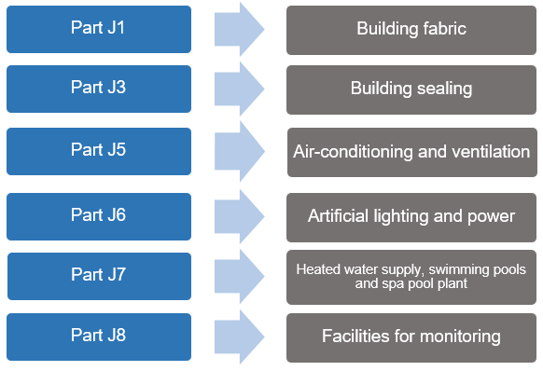
Deemed- to-Satisfy Provisions: Class 2 to 9 buildings
Part J0 – Class 2-9 buildings
All other buildings & other areas in a Class 2 building (e.g. common areas)
Notes:
Parts J1 to J8 contain the Deemed-to-Satisfy Provisions applicable to Class 2 to 9 buildings (excluding apartments (i.e. sole-occupancy units)).
This approach is a prescriptive one where each building element and service element must achieve a specific performance reflecting the more traditional Deemed-to-Satisfy approach.
Now, let’s look at each Part in more detail.

Slide 33
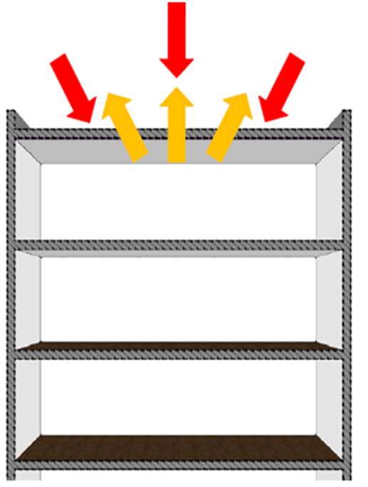
Deemed-to-Satisfy Provisions: Part J1 – Building fabric
Part J1 contains provisions for the location and installation of thermal insulation covering:
thermal construction;
roof and ceilings;
roof lights;
walls and glazing; and
floors.
Notes:
Part J1 contains the building fabric provisions. These provisions are primarily based on insulation requirements and cover:
thermal construction;
roof and ceilings;
roof lights;
walls and glazing; and
floors.
Part J1 applies the principles of reducing:
heat gain and heat loss; and
the need to condition spaces within buildings.
Although occupant comfort is not a primary goal of these provisions, one of the essential aspects of energy efficiency of a building is to ensure that the building is constructed in a manner that enhances the comfort levels of occupants to the extent that they feel less need for air-conditioning.
This is even more important in a commercial building that is likely to be air-conditioned for much of the time.

Slide 34
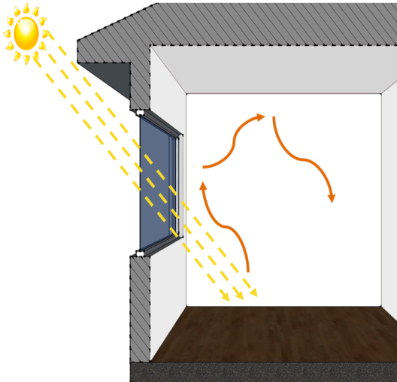
Deemed-to-Satisfy Provisions: Part J1 – Building fabric
J1.5 Walls and glazing
Part J1.5 contains the wall and glazing provisions. It specifies the requirements for walls and windows, both external and internal, that are a part of the envelope.
Good glazing design can assist in the overall energy efficiency of a building.
The ABCB has developed a façade calculator to assist NCC users to demonstrate compliance with the NCC wall and glazing provisions.
Notes:
Part J1.5 contains the wall and glazing provisions. It specifies the requirements for walls and windows, both external and internal, that are a part of the envelope. Good glazing design can assist in the overall energy efficiency of a building.
When the window makes more than 20% of the wall area then walls and windows are assessed together. You also have the ability to treat each wall separately, or you can trade values between the walls.
The most important measure in reducing the energy consumption of commercial buildings is the treatment of glazing and its interaction with artificial lighting and heating and cooling systems.
The location and size of glazing in the building includes its orientation and whether it forms part of the internal or external fabric of the building.
The ABCB has developed a façade Calculator to assist NCC users to demonstrate compliance with the NCC wall and glazing provisions.

Slide 35
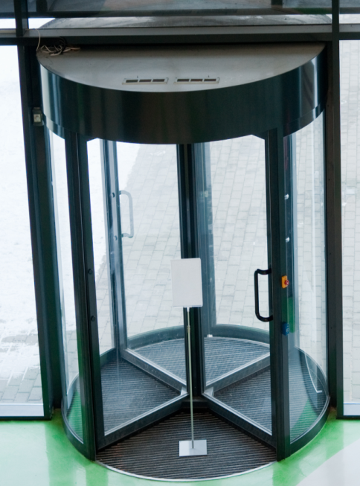
Deemed-to-Satisfy Provisions: Part J3 – Building sealing
Part J3 contains provisions for building sealing to minimise unwanted air leakage covering:
chimneys and flues;
roof lights;
windows and doors;
exhaust fans;
construction of ceilings, walls and floors; and
evaporative coolers.
Notes:
Part J3 contains the building sealing provisions. These provisions are primarily based on limiting unwanted air leakage and cover:
chimneys and flues;
roof lights;
external windows and doors;
exhaust fans;
construction of ceilings, walls and floors; and
evaporative coolers.
The Deemed-to-Satisfy Provisions for building sealing have been developed to control unwanted air leakage through the building envelope.
As with all other aspects of these Provisions, each element within Section J is designed to work as a system to ensure the building achieves the desired level of energy efficiency.
Building sealing is an integral part of this system and the control of air leakage will have a major impact on the thermal performance of the building, in particular, the capacity to reduce energy required for artificial heating, cooling and humidity control.

Slide 36
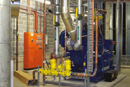
Deemed-to-Satisfy Provisions: Part J5 – Air-conditioning and ventilation systems
Part J5 contains provisions for air-conditioning and ventilation systems covering:
air-conditioning and mechanical ventilation system control;
fan systems;
ductwork insulation and sealing;
pump systems;
pipework insulation;
space heating;
refrigerant chillers;
unitary air-conditioning equipment; and
heat rejection equipment.
ABCB fan and pump system calculators are available to assist users with these requirements.
Notes:
Part J5 contains provisions for air-conditioning and ventilation systems and their associated components to limit energy use. J5 applies to Class 2-9 buildings, with the exception of Class 8 electricity network substation.
These Provisions cover:
air-conditioning and mechanical ventilation system control;
fan systems;
ductwork insulation and sealing;
pump systems;
pipework insulation;
space heating;
refrigerant chillers;
unitary air-conditioning equipment; and
heat rejection equipment.
Such HVAC (Heating, Ventilation and Air-conditioning) systems are generally responsible the largest energy end-use in a building, estimated at 43%.
The principles of Part J5 are based on the following three key points:
efficient design of air-conditioning and ventilation systems is an essential part of building environment management;
increasing demands for internal thermal comfort drive the need for energy efficient systems; and
the NCC has a range of measures that remove poor practice from new installations and encourage efficient system design.
NCC Volume One Part F4 also contains provisions for ventilation systems in addition to Part J5.
The ABCB has developed a fan system calculator and pump system calculator to assist NCC users to demonstrate compliance with the NCC fan system and pump system provisions in Part J5.
The fan system calculator allows a range of inputs, including various fan system characteristics, fouling risk, role of selected fan system, duct sizes and runs, flow rates, roughness, motor input power and more.
The pump system calculator allows a range of inputs, including pump system characteristics, speed control, operating hours, pump design, pump stage, pump speed, pump configuration, pipe details and more.

Slide 37
Deemed-to-Satisfy Provisions: Part J6 – Artificial lighting and power
Part J6 contains provisions for artificial lighting and power including:
limiting energy used for artificial lighting whilst still maintaining adequate lighting levels; and
power supply to certain equipment, including lifts and escalators.
They reflect the ongoing transition to using more energy efficient LED lighting.
The ABCB has also developed a Lighting Calculator to assist users to demonstrate compliance with these provisions.
Notes:
Part J6 contains the artificial lighting and power provisions. These provisions are primarily based on limiting energy use and cover:
energy used for artificial lighting whilst still maintaining adequate lighting levels; and
power supply to boiling water and chilled water storage units.
Research indicates that lighting is expected to be responsible for 26% of the electrical energy used in an office building.
Therefore, artificial lighting measures are designed to curb unreasonable energy use. The provisions for lighting also reflect the ongoing transition by industry and consumers to the use of more energy efficient LED lighting.
Lighting inefficiencies also have a compounding effect in warmer climates because the extra electrical load for lighting translates to waste heat that increases the load on the air-conditioning system.
The ABCB has developed a Lighting Calculator to assist NCC users to demonstrate compliance with the NCC artificial lighting provisions.
The Calculator allows a range of inputs, including floor areas, perimeter of space, ceiling heights, design illumination power load, space type, light colour, and more.
Lighting designers should also note that there is a range of adjustment factors they can use. These factors can significantly increase the amount of lighting that a space can have above the base line.
(Note 1 (reference for lighting use):
Pitt & Sherry with input from BIS Shrapnel and Exergy Pty Ltd, for the DCCEE, Baseline Energy Consumption and Greenhouse Gas Emissions – In commercial Buildings in Australia, Part 1 – Report, November 2012 (pg. 7).)

Slide 38
Deemed-to-Satisfy Provisions: Part J7 – Heated water supply and swimming pool and spa pool plant
These provisions include:
Using low greenhouse intensity energy sources for heating; and
Reducing the energy used for pumping and heating.
Provisions for heated water are located in NCC Volume Three Part B2.
Notes:
Part J7 contains provisions for heated water supply and swimming pools and spa pool plant.
These provisions are primarily based on the plant used for heating and cover:
using low greenhouse intensity energy sources; and
reducing energy used for pumping and heating.
It should be noted that the previous provisions in Part J7.2 covering heated water supply for food preparation and sanitary purposes, are now contained within Part B2 of NCC Volume Three.

Slide 39
Deemed-to-Satisfy Provisions: Part J8 – Facilities for monitoring
Part J8 contains provisions for facilities for monitoring energy use.
Notes:
Part J8 contains provisions for facilities for monitoring energy use. These provisions are based on a means for accessing energy use information for the building.
Part J8 applies to all Class 2 to 9 buildings, except within a sole-occupancy unit of a Class 2 or a Class 4 part of a building or Class 8 electricity network substation.

Slide 40
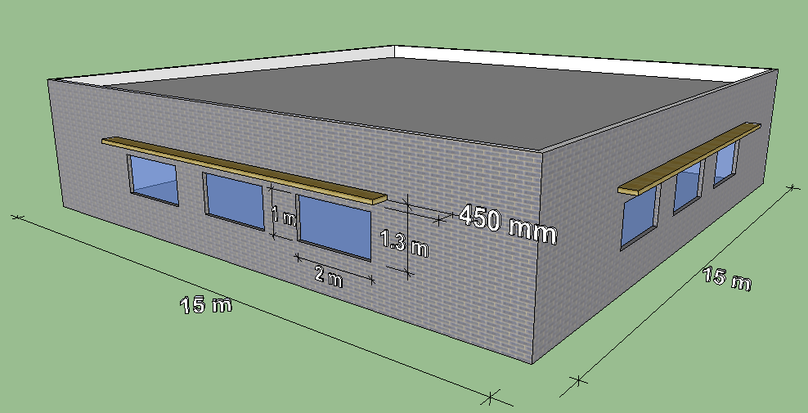
Example: Applying NCC Volume One
Now let’s look at an example of applying the building fabric Deemed-to-Satisfy Provisions (Part J1) to this small retail building in Perth.
Classification
Climate zone
Using the Façade Calculator
Building description
Wall and glazing system properties
Wall Glazing Area and calculated result
Notes:
To better understand the Part J1 – Building fabric - Deemed-to-Satisfy Provisions for walls and glazing, let’s consider an example.
The next few slides follow on from what we have just presented in the context of a small retail building.
Listed on the right hand side of the screen are some of the items we need to consider in applying the Provisions and more specifically using the Façade Calculator.

Slide 41
Example: Applying NCC Volume One
What is the Classification?
Classification
Climate zone
Using the Façade Calculator
Building description
Wall and glazing system properties
Wall Glazing Area and calculated result
Answer: Class 6
Notes:
Firstly we will need to determine the classification of the proposed building as per Part A6 in Volume One.
Answer: The retail building would be classified as a Class 6 building.

Slide 42
Example: Applying NCC Volume One
If this retail building is to be built in Perth, what climate zone is it in?
Classification
Climate zone
Using the Façade Calculator
Building description
Wall and glazing system properties
Wall Glazing Area and calculated result
Answer: Climate zone 5
Notes:
Next we will need to determine the climate zone of the proposed building using the climate zone map in Figure 2 of Schedule 3 in NCC Volume One.
Answer: The climate zone for Perth is climate zone 5.

Slide 43
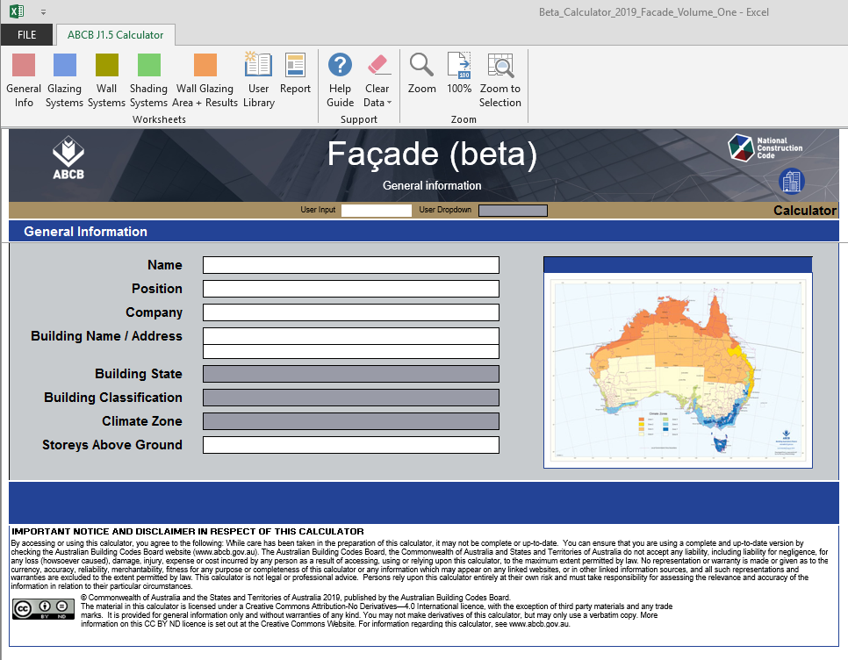
Example: Applying NCC Volume One
Now let’s look at using the Façade Calculator to assess wall and glazing compliance to the Deemed-to-Satisfy Provisions (Part J1).
Classification
Climate zone
Using the Façade Calculator
Building description
Wall and glazing system properties
Wall Glazing Area and calculated result
Notes:
Now that we’ve determined some basic building details, let’s have a look at using the Façade Calculator to assess the energy efficiency compliance of the wall and glazing to the Part J1 Deemed-to-Satisfy Provisions.

Slide 44
Example: Applying NCC Volume One
To use the Façade Calculator, we’ll follow a five step process. The first step is to enter general information about the building. This includes address, building classification, climate zone and storeys above ground.
Classification
Climate zone
Using the Façade Calculator
Building description
Wall and glazing system properties
Wall Glazing Area and calculated result
Notes:
In using the Façade Calculator, there is a five step process.
The first step is to enter general information about the building. This includes address, building classification, climate zone and storeys above ground.
Select the General Info worksheet on the ribbon tab of the Façade Calculator to enter these details into the General Information worksheet.

Slide 45
Example: Applying NCC Volume One
The second step is selecting the Glazing Systems worksheet on the ribbon tab and then enter the relevant glazing details.
Classification
Climate zone
Using the Façade Calculator
Building description
Wall and glazing system properties
Wall Glazing Area and calculated result
Notes:
The second step is selecting the Glazing Systems worksheet on the ribbon tab and then enter the relevant glazing system details. These include:
Glazing Reference – ie an reference identifier;
System Type – e.g. awning, sliding or casement type;
Glass Type – e.g. single glazing, double glazing, double low e glazing;
Frame Type – e.g. aluminium, timber, steel;
Methodology – e.g. either AFRC (true module size) or WERS (default module size);
Total System U-Value – i.e. the thermal transmittance value for the whole window; and
Total System SGHC – i.e. the value for transmitting solar irradiance.
A maximum of 16 glazing systems are allowed within the Calculator for any one project.

Slide 46
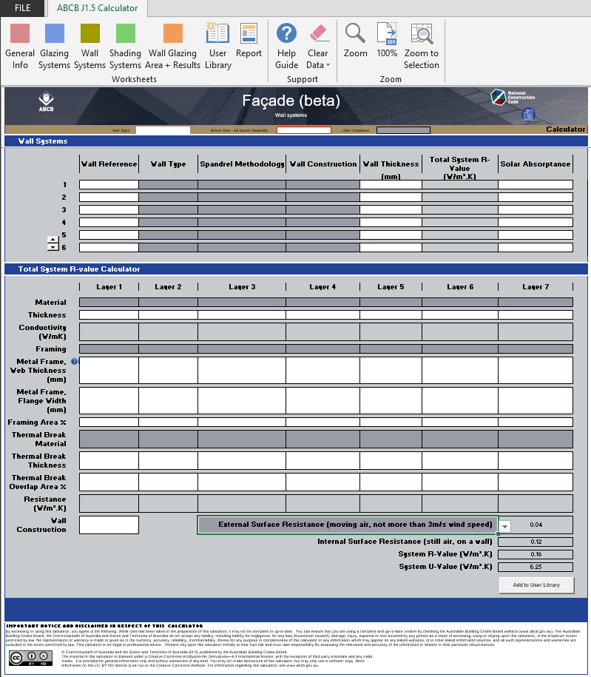
Example: Applying NCC Volume One
The third step is selecting the Wall Systems worksheet on the ribbon tab and then enter the relevant wall system details.
Classification
Climate zone
Using the Façade Calculator
Building description
Wall and glazing system properties
Wall Glazing Area and calculated result
Notes:
The third step is selecting the Wall Systems worksheet on the ribbon tab and then enter the relevant wall system details. These include:
Wall reference;
Wall type;
Spandrel methodology;
Wall construction;
Wall thickness
Total System R-Value; and
Solar absorptance.
A maximum of 16 wall systems are allowed within the Calculator for any one project.

Slide 47
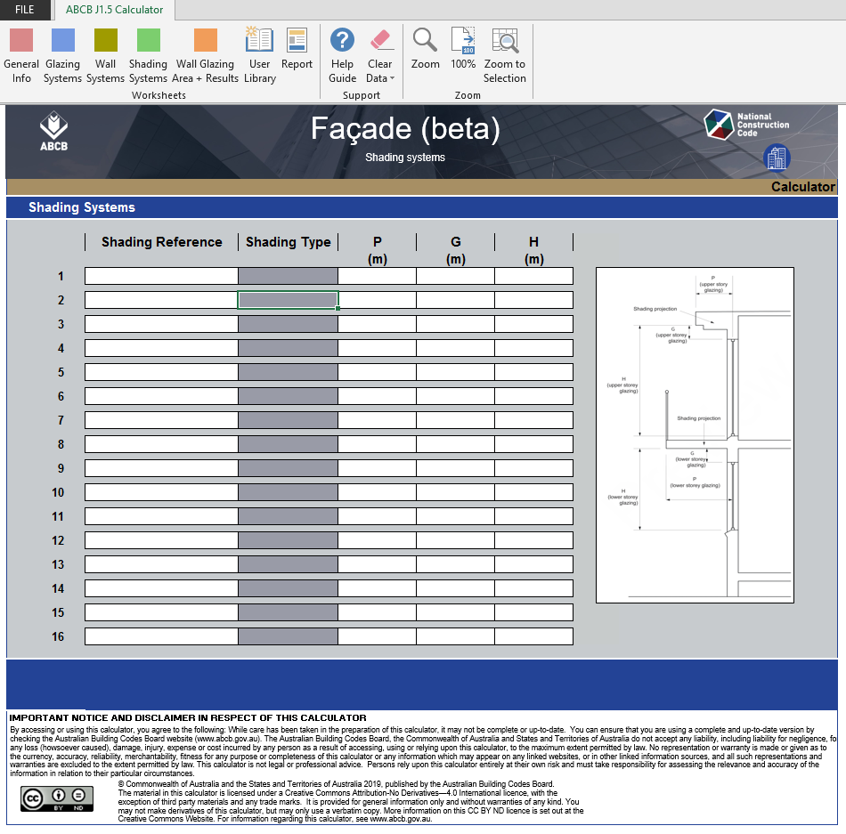
Example: Applying NCC Volume One
The fourth step is selecting the Shading Systems worksheet on the ribbon tab and entering the relevant shading system details.
Classification
Climate zone
Using the Façade Calculator
Building description
Wall and glazing system properties
Wall Glazing Area and calculated result
Notes:
The fourth step is selecting the Shading Systems worksheet on the ribbon tab and entering the relevant shading system details. These include:
Shading reference; and
Shading type – this cell requires a selection of a horizontal shading system or ‘device’.
A maximum of 16 shading systems are allowed within the Calculator for any one project.

Slide 48
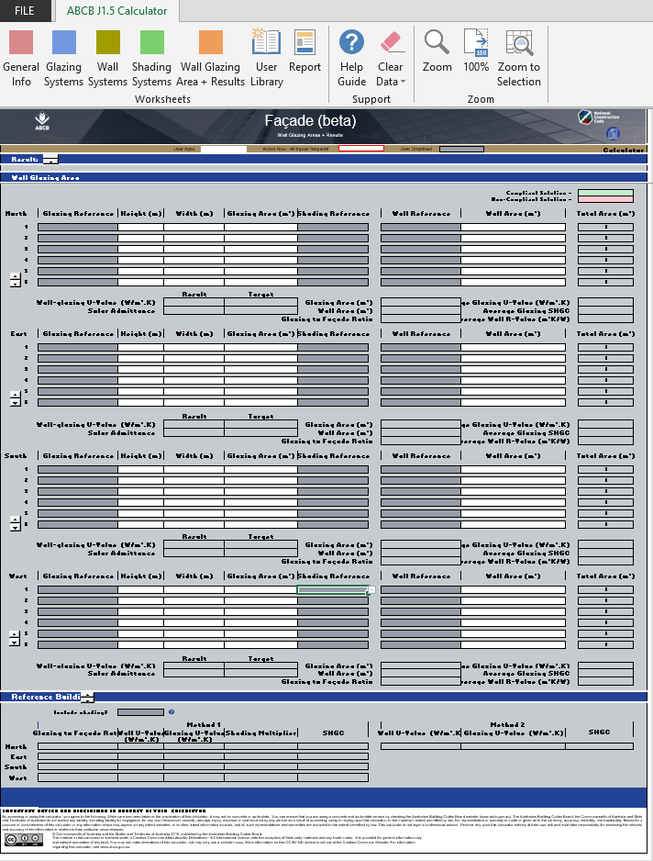
Example: Applying NCC Volume One
The fifth and final step is selecting the Wall Glazing Area + Results worksheet on the ribbon tab.
Classification
Climate zone
Using the Façade Calculator
Building description
Wall and glazing system properties
Wall Glazing Area and calculated result
Notes:
The fifth and final step is selecting the Wall Glazing Area + Results worksheet on the ribbon tab.
The Wall Glazing Area + Results sheet combines the project’s general information, Glazing Systems, Wall Systems, Shading Systems and areas to calculate the J1.5 Wall and glazing results as a function of their area.
References specified in Glazing Systems, Wall Systems and Shading Systems can be allocated to four cardinal directions (North, East, South and West). Wall and glazing areas are then applied to each glazing and wall reference.
As per Specification J1.5a in NCC Volume One, there are two methods, Method 1 and Method 2, to determine the U-Value and solar admittance of a wall-glazing construction.
Method 1 results are presented below each orientation. A summary of both Method 1 and Method 2 results for all orientations are provided in the Results tab at the top of the sheet.
The proposed design chart must fall under the Deemed-to-Satisfy reference line in the Method 1 and Method 2 results graphs for both wall-glazing U-Value and solar admittance.
The Façade Calculator also has a Help Guide contained within to provide further guidance on using the Calculator and the Handbook: Energy Efficiency Volume One contains further information on the Calculator and detailed descriptions of the format and key cells in the Calculator to explain its use.

Slide 49
Guide to NCC Volume One
The Guide to NCC Volume One provides additional and non-mandatory explanatory information.
The Guide is used to provide additional guidance on the application of the particular Parts, clauses and defined terms.
The Guide is accessed by hyperlinks in the each section of NCC Volume One online at ncc.abcb.gov.au.
Notes:
Now we’ve finished a brief overview of the requirements and worked through an example, there’s some other support material you should be aware of.
To help better understand NCC Volume One, additional explanatory information is provided in the Guide to Volume One.
The Guide is non‐mandatory and is used to provide additional guidance on the application of the particular Parts, clauses, and defined terms.
The Guide is integrated into NCC Volume One online at ncc.abcb.gov.au.

Slide 50
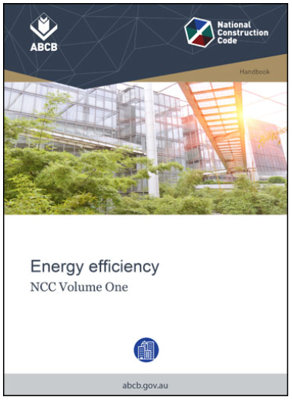
Handbook
The ABCB has developed a non-mandatory Handbook: Energy efficiency for NCC Volume One
It assist in understanding and applying the Volume One energy efficiency requirements.
Notes:
The Australian Building Codes Board, or ABCB has developed a non-mandatory Handbook, NCC Volume One Energy Efficiency to assist understand the energy efficiency requirements in Volume One.

Slide 51
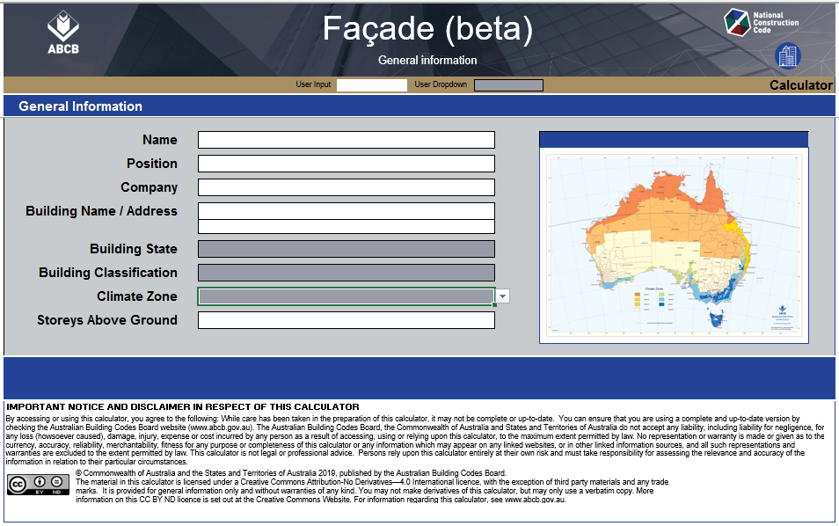
Energy efficiency calculators
The ABCB has developed a range of calculators to assist practitioners to develop energy efficient building solutions. Relevant calculators for energy efficiency include the:
Façade calculator;
Fan systems calculator;
Pump systems calculator; and
Lighting calculator.
abcb.gov.au
Notes:
The ABCB has developed a range of calculators to assist practitioners to develop energy efficient building solutions. Relevant calculators for energy efficiency include the:
Façade calculator;
Fan systems calculator;
Pump systems calculator; and
Lighting calculator.
All ABCB Calculators can be downloaded from the ABCB website, abcb.gov.au.

Slide 52
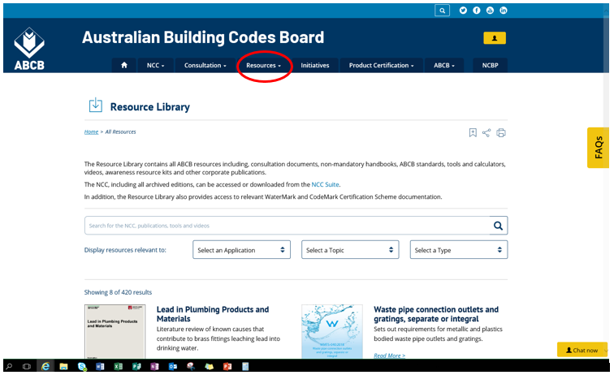
Need more help?
Notes:
To help you better understand the NCC, the ABCB's Resource Library is your one-stop shop to access all of the ABCB’s educational materials.
Visit abcb.gov.au and select the Resources tab to get started.

Slide 53
Summary
Upon completion, you will have gained a basic understanding of the energy efficiency provisions in NCC Volume One, covering:
background and objectives for energy efficiency;
defined terms;
Performance Requirements;
Verification Methods;
Deemed-to-Satisfy Provisions;
The Guide to Volume One and other energy efficiency related resources; and
Applying the provisions using an example
Notes:
Upon completion, you’ll have gained a basic understanding of the energy efficiency provisions of Volume One, including:
Background and objectives of the NCC energy efficiency provisions;
defined terms;
Performance Requirements;
Verification Methods; and
Deemed-to-Satisfy Provisions; The Guide to Volume One and other energy efficiency related resources; and
Applying the provisions using an example.

Slide 54
Assessment Questions
Answers are indicated in red.
Question 1
True or false? The role of the NCC is to provide nationally consistent, minimum necessary regulations.
True
False.
Question 2
Volume One of the NCC contains:
The design and construction requirements for Class 2-9 buildings
Plumbing and drainage requirements for plumbing associated with all classes of buildings
The design and construction requirements for house construction.

Slide 55
Assessment Questions (continued)
Question 3
According to the NCC, which of the following is NOT a recognised climate zone?
Climate zone 1 - High humidity summer, warm winter
Climate zone 2 - Warm humid summer, mild winter
Climate zone 3 - Hot dry summer, mild winter
Climate zone 9 – Wet summer, Wet winter.
Question 4
True or false? In Section J, identifying the “envelope” of the building is reliant on knowing which areas are conditioned and non-conditioned or external to the building.
True
False.

Slide 56
Assessment Questions (continued)
Question 5
JP1 is the relevant Performance Requirement for energy efficiency in NCC Volume One. It requires a building, including its services, must have features that facilitate the efficient use of energy appropriate to:
The function and use of the building
The energy source of the services
The sealing of the building envelope against air leakage
All of the above, plus features for capturing and controlling solar radiation, conditioned spaces and human comfort.
Question 6
True or false? The NCC energy efficiency provisions primarily address the thermal performance of a building and the efficiency of its services.
True
False.

Slide 57
Assessment Questions (continued)
Question 7
Part J1 of NCC Volume One applies the principles for reducing what?
Heat gain and heat loss and the need to condition spaces within buildings
Use of inefficient lighting
All of the above
None of the above.
Question 8
In applying the NCC energy efficiency provisions what are the two main elements glazing and walls are assessed on?
Thermal mass and natural air movement
Conductance and solar heat gain
Building sealing and ventilation .

Slide 58
Assessment Questions (continued)
Question 9
Performance Requirement JP1 seeks to improve energy efficiency. It considers:
Facilitating the efficient use of energy relevant to the function, use and geographic location of the building
The conditioned space of the building
All of the above
None of the above.
Question 10
True or false? There are three mandatory Performance Requirements for energy efficiency listed in Section J of NCC Volume One.
True
False.

Slide 59
Assessment Questions (continued)
Question 11
What does Verification Method JV3 apply to?
A whole reference / proposed building, i.e. both the entire reference and proposed building must be modelled
Class 3, 5, 6, 7, 8, or 9 buildings or a common area of a Class 2 building
The proposed building must equal or exceed the performance of the Deemed-to-Satisfy Provisions (through comparison to the reference building)
All of the above.
Question 12
Complete this sentence - an energy rating for apartments is…?
A quantified benchmark used to describe energy efficiency (in stars)
Based on an annual energy load and climate
Derived from using NatHERS accredited computer software tools
Based on a numeric scale of energy load from zero to ten
All of the above
None of the above.

Slide 60
Copyright, Attribution & Disclaimer
Copyright
© Commonwealth of Australia and the States and Territories of Australia 2020, published by the Australian Building Codes Board.
The material in this publication is licensed under a Creative Commons Attribution—4.0 International licence, with the exception of: any third party material, any trademarks, and any images or photographs. More information on this CC BY licence is set out at the Creative Commons Website. Enquiries about this publication can be sent to: Australian Building Codes Board ,GPO Box 2013, CANBERRA ACT 2601. Phone: 1300 134 631, Email: ncc@abcb.gov.au www.abcb.gov.au.
Attribution
Use of all or part of this publication must include the following attribution:
© Commonwealth of Australia and the States and Territories 2020, published by the Australian Building Codes Board.
Disclaimer
By accessing or using this publication, you agree to the following:
While care has been taken in the preparation of this publication, it may not be complete or up-to-date. You can ensure that you are using a complete and up-to-date version by checking the Australian Building Codes Board website (www.abcb.gov.au).
The Australian Building Codes Board, the Commonwealth of Australia and States and Territories of Australia do not accept any liability, including liability for negligence, for any loss (howsoever caused), damage, injury, expense or cost incurred by any person as a result of accessing, using or relying upon this publication, to the maximum extent permitted by law. No representation or warranty is made or given as to the currency, accuracy, reliability, merchantability, fitness for any purpose or completeness of this publication or any information which may appear on any linked websites, or in other linked information sources, and all such representations and warranties are excluded to the extent permitted by law.
This publication is not legal or professional advice. Persons rely upon this publication entirely at their own risk and must take responsibility for assessing the relevance and accuracy of the information in relation to their particular circumstances.

